Slide 1

CYBERWATCHING
Creating a global living lab including cybersecurity aspects as a guarantee

Slide 2
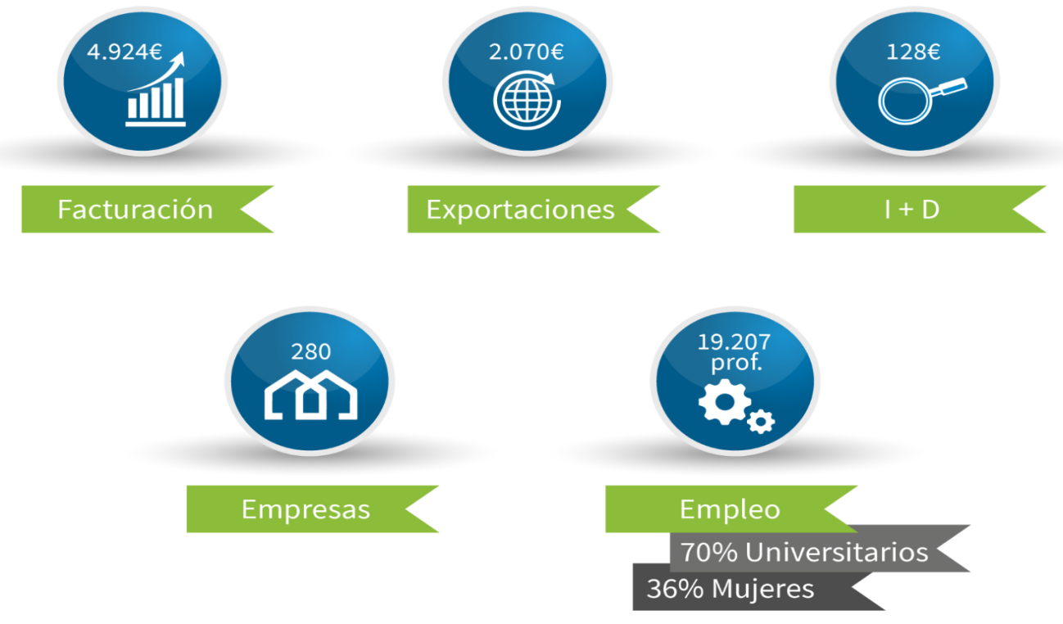
THE ICTA SECTOR IN EUSKADI
Industry of Knowledge and Applied Technology
The ICTA Basque Country sector constitutes a competitive advantage to accelerate the transformation of companies, territory and society with the aim of positioning Euskadi in the New Economy. The new GAIA cluster is created with the intention of promoting this transformation through opportunities to generate wealth.
ICTA Sector
A strongly internationalized sector, which generates Employment, Wealth, and Innovation
  It is equivalent to more than 7% of Euskadi's GDP
(*) Millones de €

Slide 3
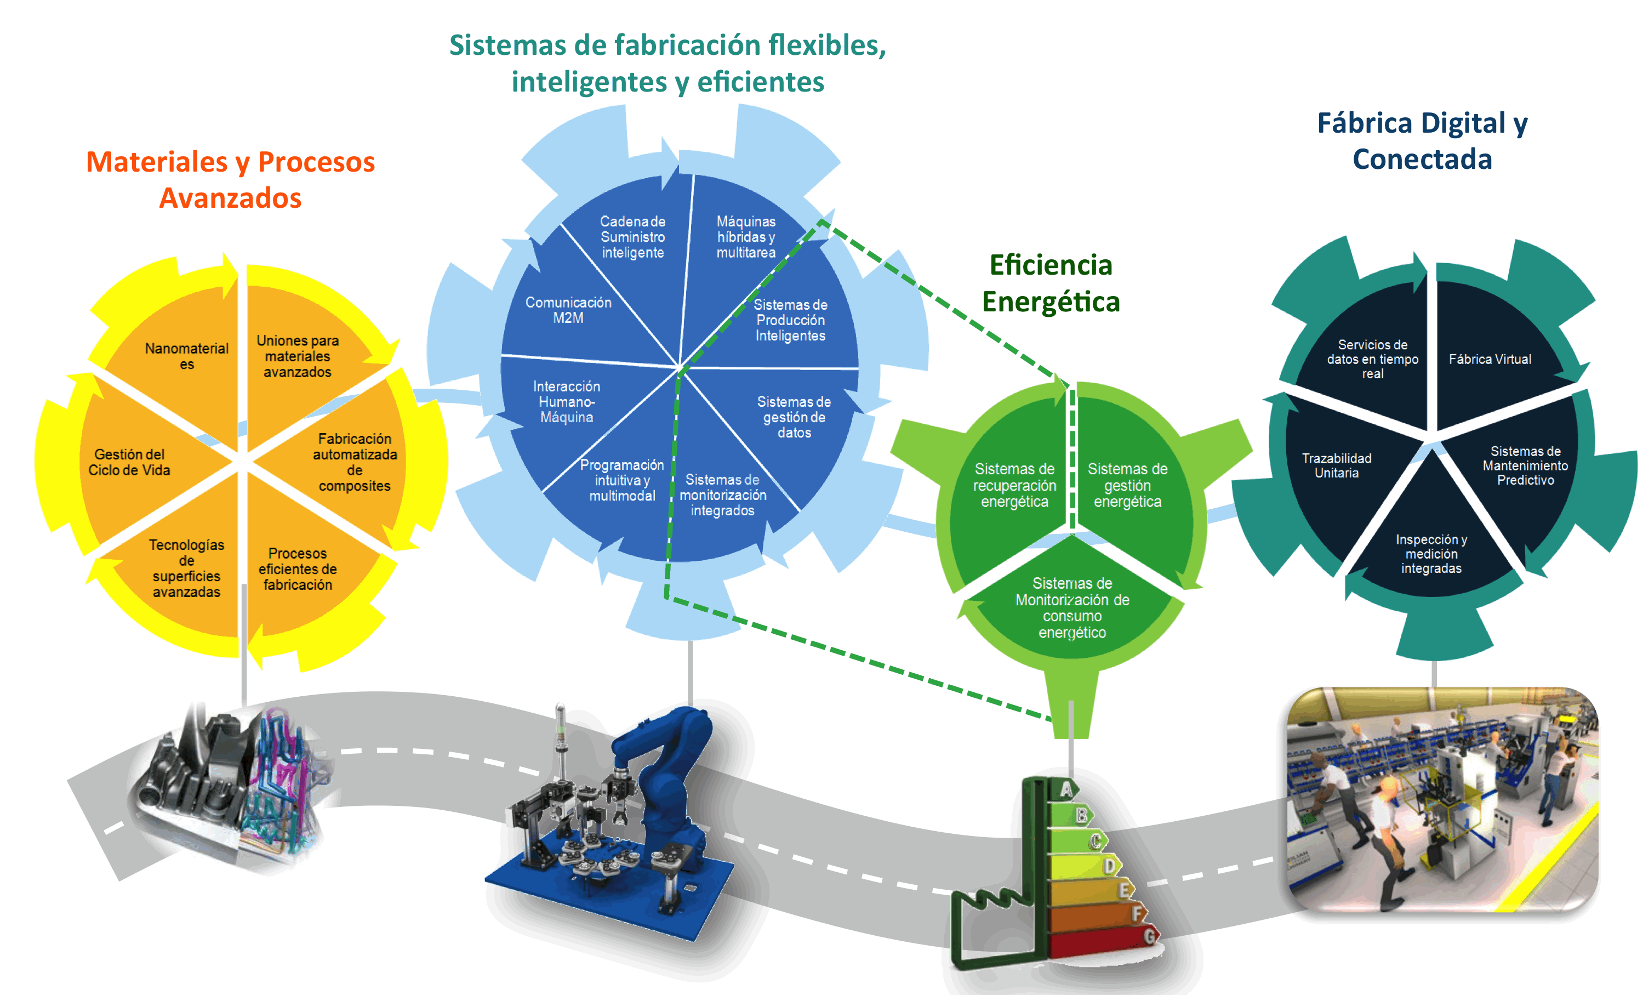
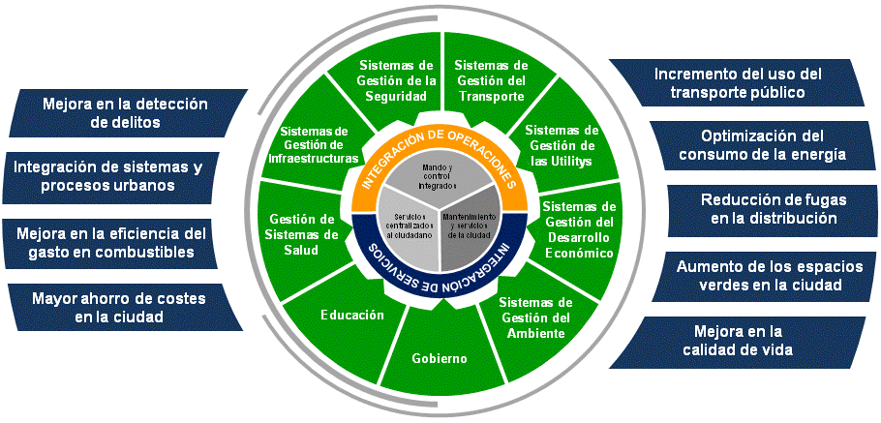
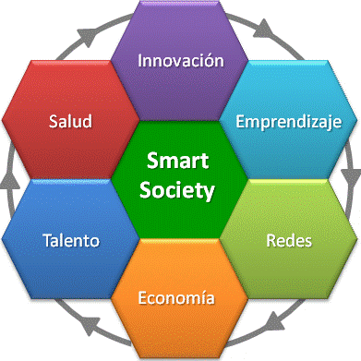
WHAT DO WE DO?
A sector with commitment in the main Opportunity Spaces
The ICTA sector companies create, develop and offer advanced solutions for all sectors: industry, services, Public Administration and Society.
The Strategic Plan 2017 - 2020 aligns the offer of the companies of the sector towards the specialization in the development of Projects referring, to Collaborative Innovation, in three Spaces of Opportunity.
Smart Industry
Industry 4.0 & Energy
Smart Territory
Smart Society
  Models and systems for management and improvement of processes, products and organizations:
  Service and Business
  Energy Management
  New Economy Services in Industry 4.0
  Advanced infrastructure and platforms:
  Governance
  Sustainable Environment
  Digitized services for citizens and businesses
  New Economy Services in Industry 4.0
  Advanced systems for the promotion and improvement of citizen-centered areas:
  Talent and entrepreneurship.
  Citizens' living environment.
  Participation and Communication
  New Economy Services in Society 4.0

Slide 4
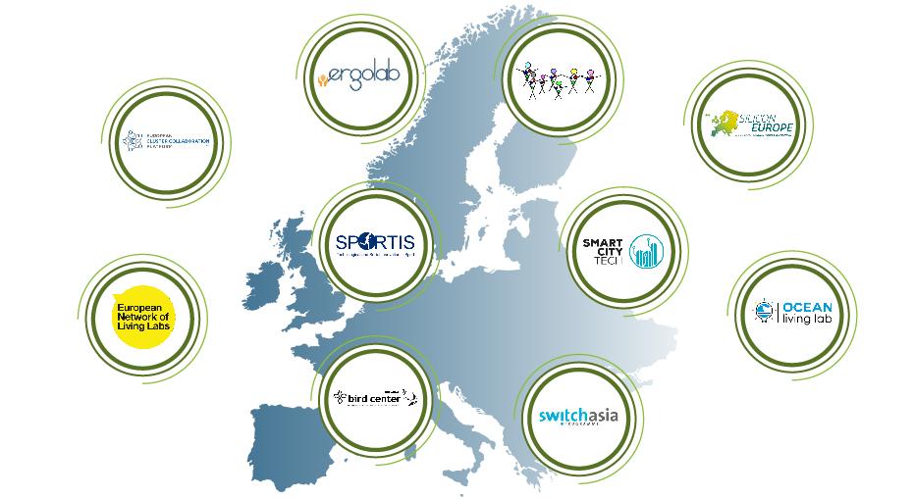
A COMMITTED CLUSTER WITH THE INTERNATIONALIZATION
As a result of the joint of GAIA + AVIC, we form a cluster which groups 280 members with the support of 12 professionals in two headquarters (Donostia and Bilbo).
      Additionally, GAIA is an active member of a big range of alliances and business networks at European and international levels. In the European scope, GAIA is involved in the next networks:
  Actually, there are 15 alliances, of different kind, which additionally have generated 6 support infrastructures to the ICTA sector companies.
  One of the initiatives with positive outcome which GAIA promotes, is the constitution of Strategic Alliances. These alliances which members participate are lead by their own and in some occasions by GAIA.

Slide 5
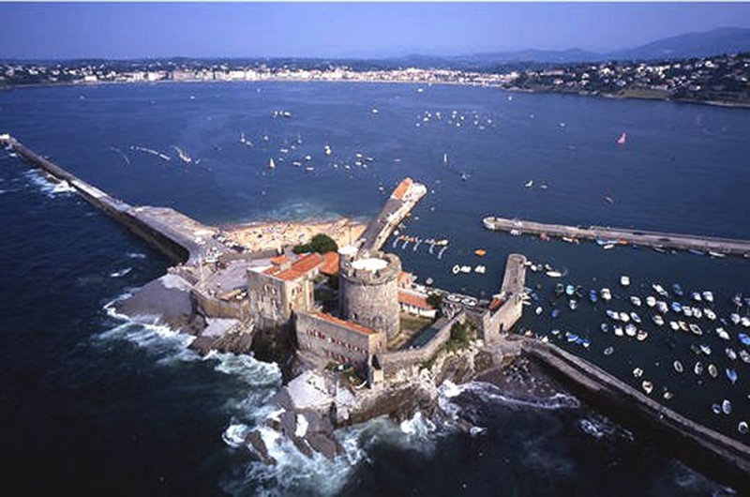
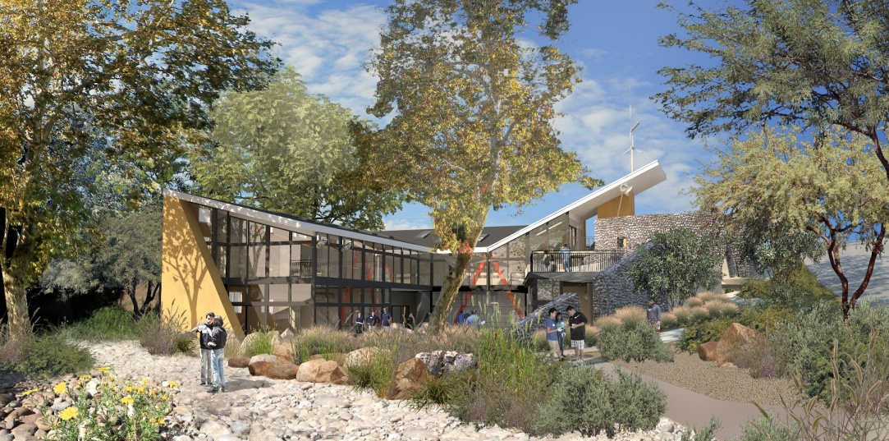
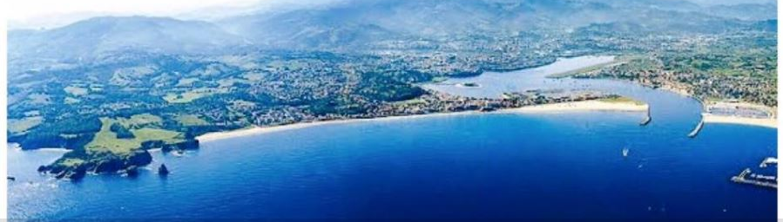
OCEANTECH ECOSYSTEM
First trans-boundary Living Lab
First trans-boundary Living Lab certified by EnoLL (European Network of Living Labs) for the promotion of innovation on water activities and sports in the Aquitany (France) – Euskadi (Spain) Euroregion: promoting the sector, increasing competitiveness.
European reference centre for the Ocean sector, sliding and aquatic activities
Connecting companies in the territory

Slide 6
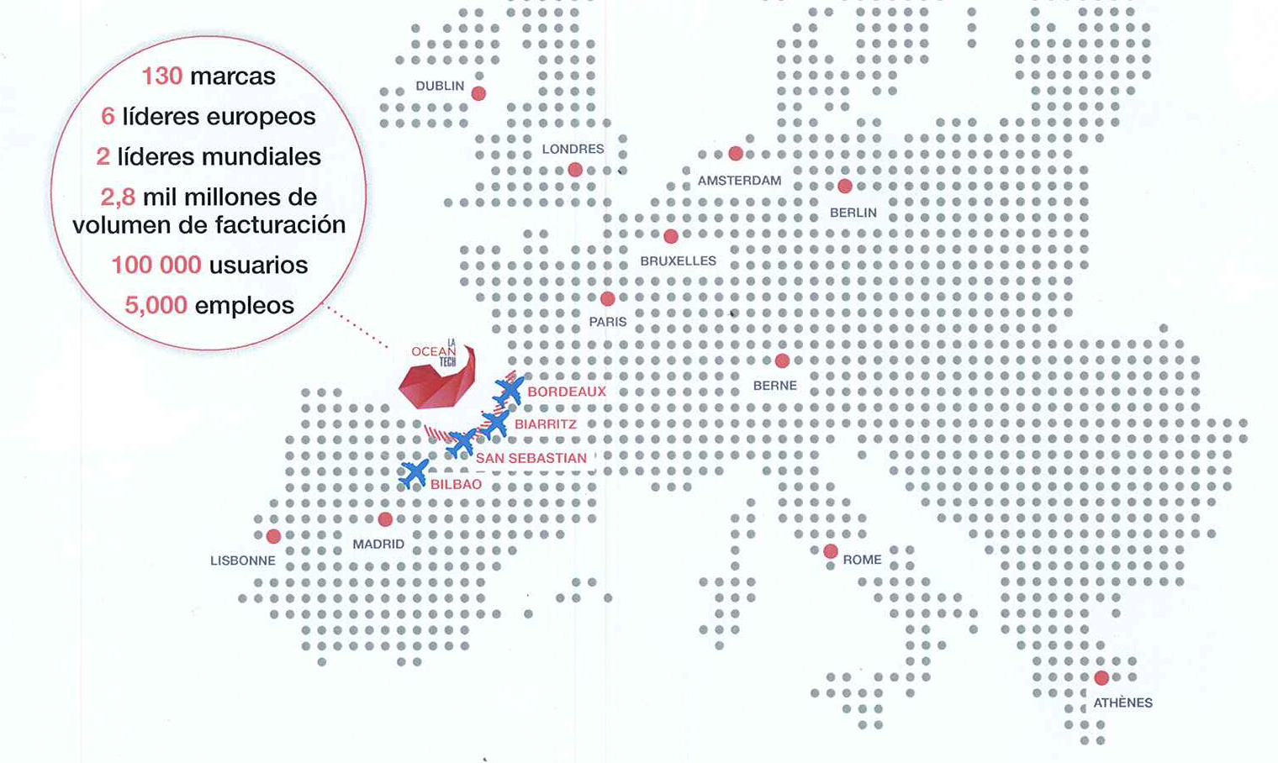


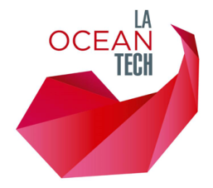
OCEANTECH, A START-UP ECOSYSTEM
To train, to prototype, to test
OCEANTECH is certified by the French start up ecosystem, French Tech, which has the support of the government to encourage the development of new companies.
The startup ecosystem turns our cross-border space into a world reference in the field of digital design of new products and services related to the sea, sliding sports and water sports.

Slide 7
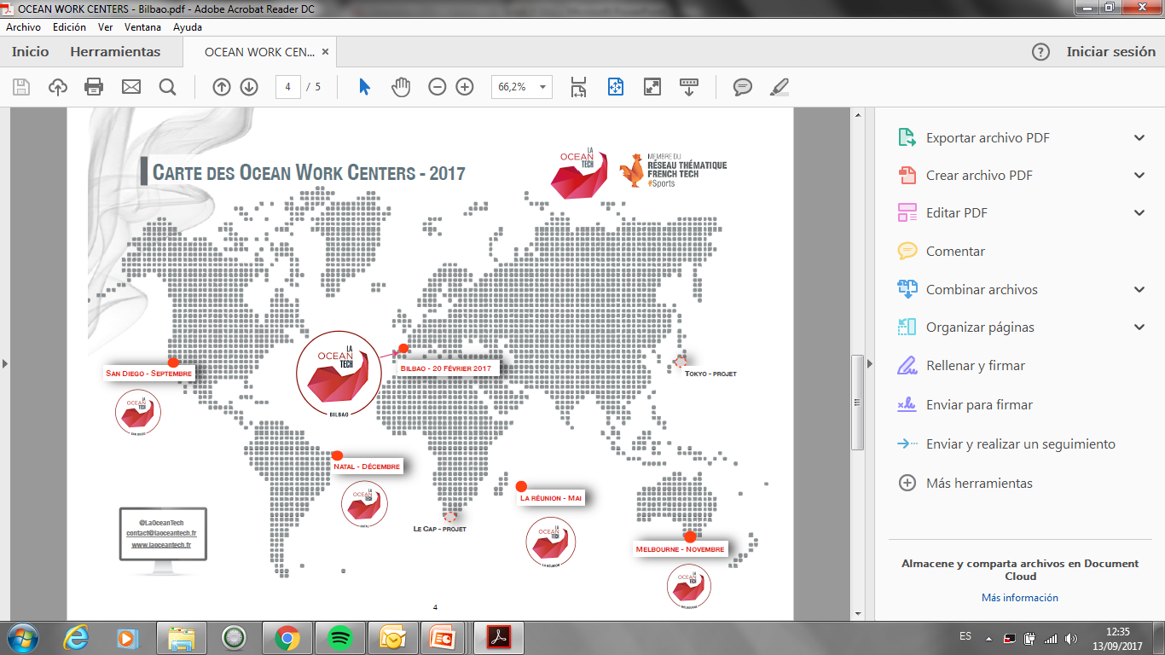
INTERNATIONAL STRATEGY
The Ocean Work Center Network

Slide 8
PROJECT EXPLOITATION STRATEGY
Security in beach and ocean related activities
SECURITY
PEOPLE
DIGITALIZATION
TRAINING
CYBERSECURITY
Organic Electronics in BlueSports products
Technologies and services for a 24h lifeguard system
Cybersecurity solutions for IoT and outdoor connected objects
Cross-border strategy for minority languages (Basque)
Training on sustainable sports
Cross-border training in new technologies for sports
New cybersecurity solutions for indoor services (protection of sensitive data)
Platform positioning and preservation of confidentiality

Slide 9
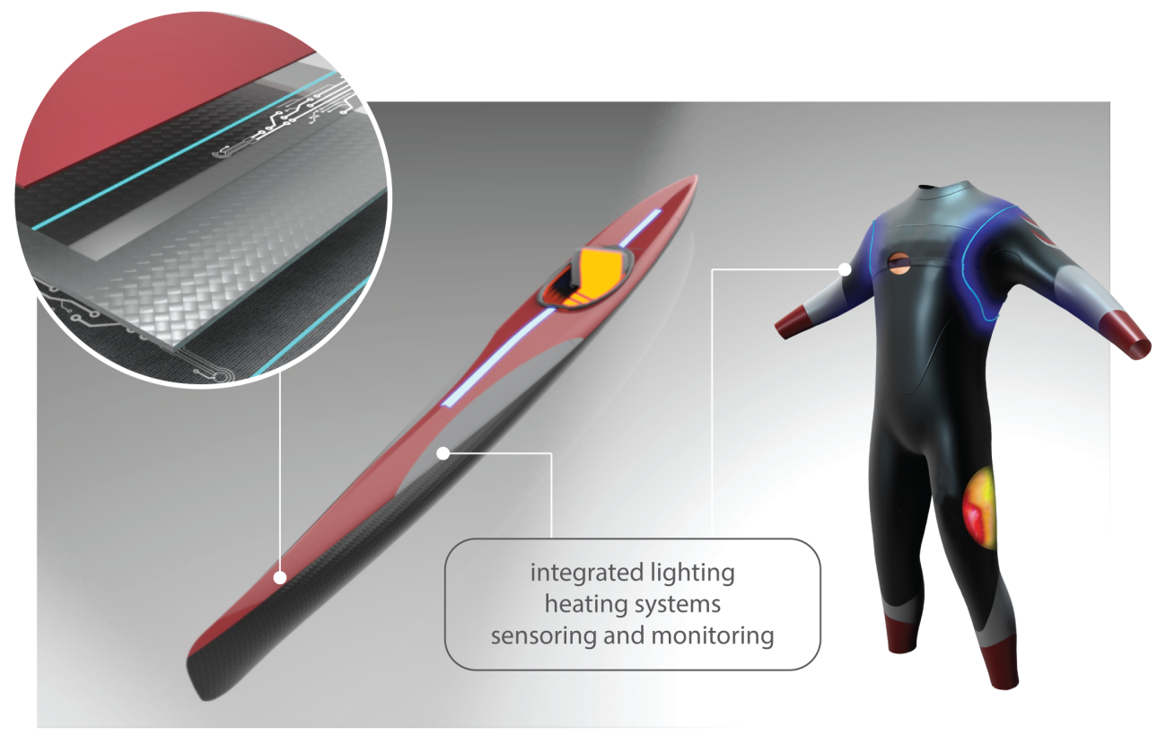
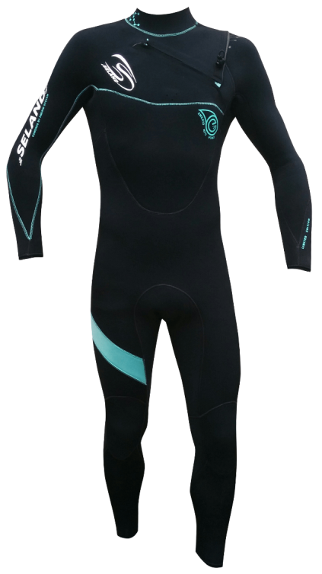
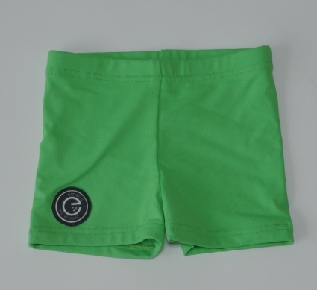
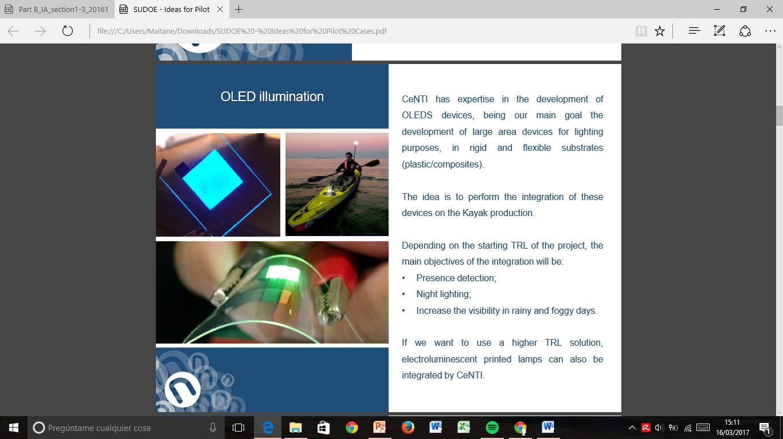
PEOPLE
New technologies to increase the security of people in beaches

Slide 10
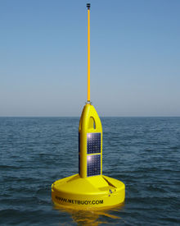
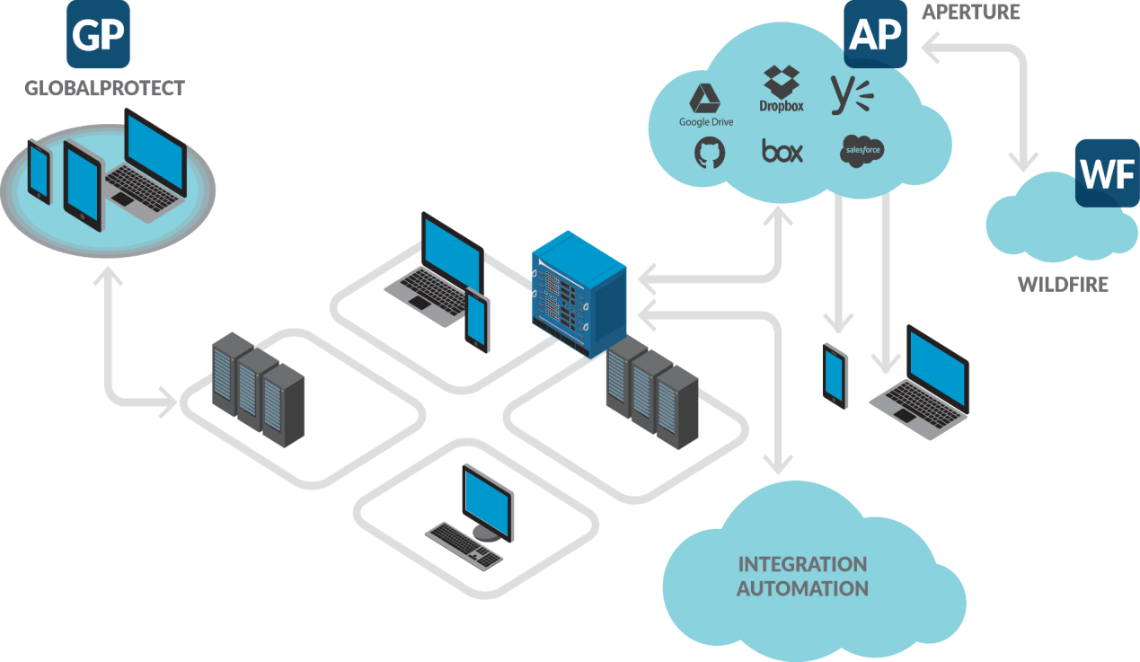
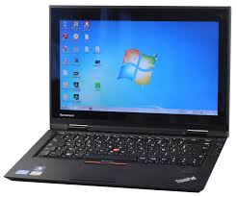
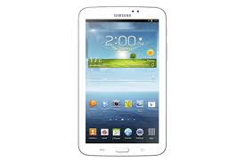
CYBERSECURITY
OceanLive Cybersecurity network development to ensure the safety of all connected systems (IoT)

Slide 11

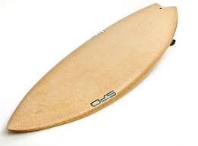

DIGITALIZATION
Using Qwant, the confidentiality preservation research engine to promote the ecosystem: activities, start-up, tourism, sports

Slide 12

TRAINING
Establishment of networks of key cross-border actors for employment, as well as the exchange of good practices and the development of an offer in training in cutting-edge technologies for BlueSports
EJOBS 4 SPORTS

Slide 13
Thank you very much
Muchas gracias
Eskerrik asko
Jokin Garatea
garatea@gaia.es
Director of the International Department

