Slide 1
Opportunities for Cybersecurity and Privacy clusters
Nicholas Ferguson, Trust-IT Services
Coordinator, cyberwatching.eu
10 July, 2018

Slide 2
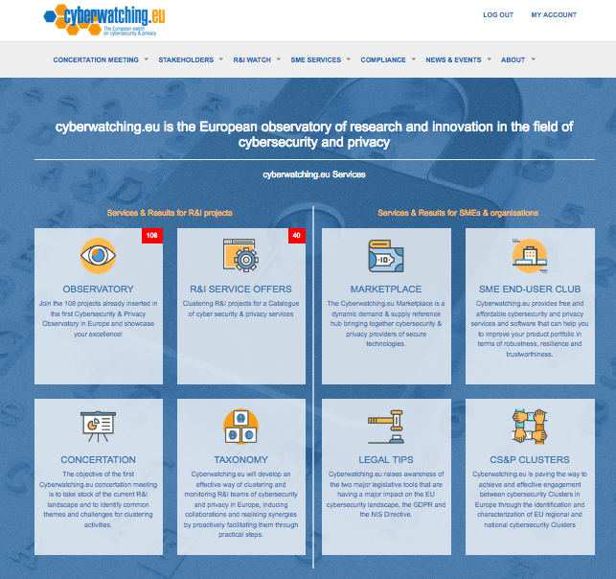
cyberwatching.eu – The European watch on Cybersecurity and Privacy
May 2017 - April 2021 and beyond
Consortium
R&I Projects
Small Business

Slide 3
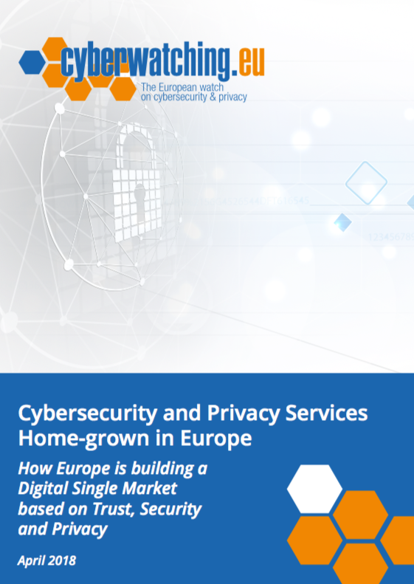
Coordination of CS&P R&I in Europe
R&I Observatory
Cluster projects
Concertation & events
Marketplace
SME End-user club
Standards, legal & policy
R&I Service Offer Catalogue
Showcase EU excellence
Synergise with CS&P clusters
TRL & market readiness training
innovative solutions, services, products from R&I and SMEs
SMEs can validate, test, adopt services
Use new services from R&I projects
Guides on Legal, cyberinsurance, certification.
Workshops & events
R&I Taxonomy
Cluster R&I projects
Map standards & certification
Legal best practices
Identify EC, National & Regional CS&P projects.
Notes:
Easy finding of innovative solutions
Stakeholders can interact with the respective solution providers
Synergy-ignition levers

Slide 4
Cost-effective Cybersecurity and Privacy Home-grown in Europe
Enterprises intangible risk management via economic models based on simulation of modern cyber attacks
Holistic risk assessment model to support investment descisions
Healthcare, Financial services – SME & industry CIOs, Insurers & analysts
Cyber Security Accelerator for trusted SMEs IT Ecosystem
Minimize the exposure of SMEs to cyber security risks and threats
Help SMEs respond to incidents, without the effort of identifying, acquiring and using the appropriate cyber security solutions
Enhancing Critical Infrastructure Protection with Innovative Security Framework
Orchestrate security products and services
Health, Railway Transport, Environment & Multi-domain - SMEs
Protecting Small and Medium-sized Enterprises digital technology through an innovative cyber-SECurity framework
Framework with CS tool-kits for network information security risks and threats
IoT systems, smart cities, e-voting, smart grids, consumer electronics, smart manufacturing, connected health
Ready for testing/validation/adoption 2019-2020

Slide 5
Agenda
10:00 - 10:07 | Cyberwatching.eu - The EU Cybersecurity & Privacy Observatory Nicholas Ferguson. Trust-IT Services & Cyberwatching.eu Coordinator
10:08 - 10:20 | Opportunities in Horizon 2020. Mrs. Maite Boyero. Spanish Secure Societies NCP representative
10:20 - 10:32 | Promoting Cybersecurity opportunities in a globalized industry, Oceans. Mrs. Itziar Vidorreta, GAIA cluster, Spain
10:33 - 10:45 | Tips and recommendations to minimize cyber-risks in SMEs, is it time for a cyber-insurance? Mr. Francesco Manca, AON, Italy
10:45 - 10:57 | Creation of opportunities in new markets in Cybersecurity and Privacy. Mr. Andrei Kelemen, ClujIT, Romania
10:58 - 11:05 | Q&A
WRITE YOUR QUESTIONS IN THE CHAT IN THE SIDE BAR
We are recording

Slide 6
Thank-you
48 EU Cybersecurity & Privacy Services from EU R&I
www.cyberwatching.eu/services/catalogue-of-services
Ready for validation/testing/product 2018-2022
GDPR & NIS compliant
Complete our survey on certification and standards
https://www.cyberwatching.eu/gaps-survey
Contact
Nick Ferguson, Cyberwatching.eu Coordinator Trust-IT Services Ltd – www.trust-itservices.com
n.ferguson@trust-itservices.com

