Slide 1
Cyber Risk & Cyber Insurance - Overview

Slide 2
Cyber Risk Management | Adopting a Risk-Based Cyber Insurance Strategy
Assess
Quantify
Transfer
Respond
Helping clients optimise the total cost of risk associated with cyber exposures
Holistic integration with Enterprise Risk Management (ERM) framework:
appetite, financing, and insurance
Includes harmonized input from Compliance, Legal, Finance, HR, BUs, Internal Audit
+ Cybersecurity and IT

Slide 3
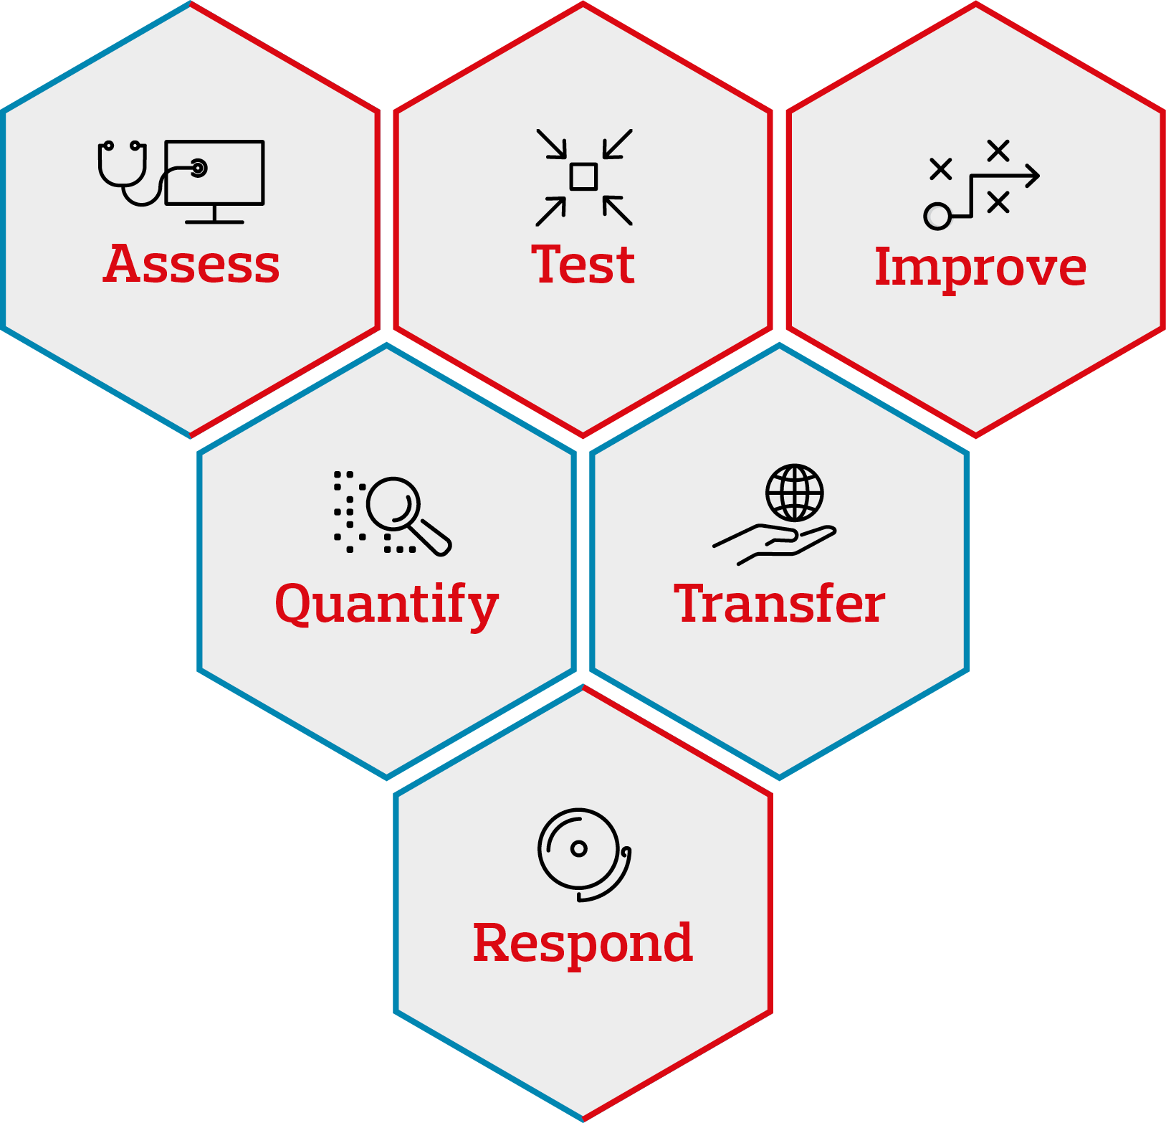
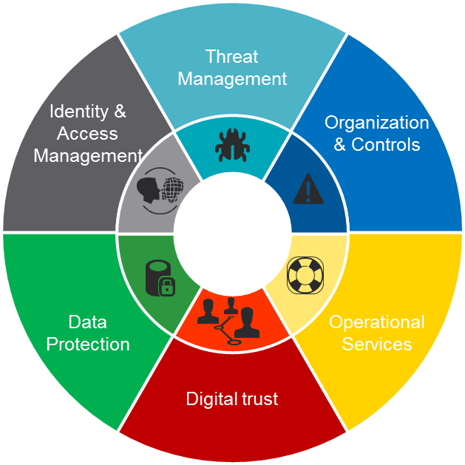
The "integrated" path towards continuous improvement of information security
  Strategy
  ISMS
  Training and awareness
  Governance and processes
  Asset evaluation and data classification
  Policy
  Reporting
  Threat intelligence
  Vulnerability Management
  Penetration Test
  Ecc.
  Identity and access management
  Access review
  Segregation of duties
  Ecc.
Cyber
  GDPR
  Data privacy management
  Data privacy governance
  Security Monitoring
  Incident Response e Data Breach MGMT
  Network & host security
  Business Continuity Management & DR
  Change Management
  Cloud Protection
  IOT cybersecurity
  Security Awareness
  …
Cyber Risk
Management
Cybersecurity
Management

Slide 4


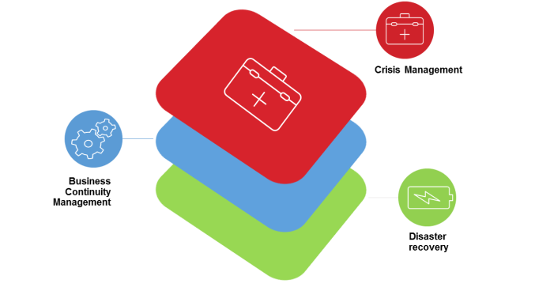


Elements aimed at mitigating the cost of the insurance policy
Revenues from
Online activities
IAM
BCM & DR
BACKUP
AWARENESS

Slide 5
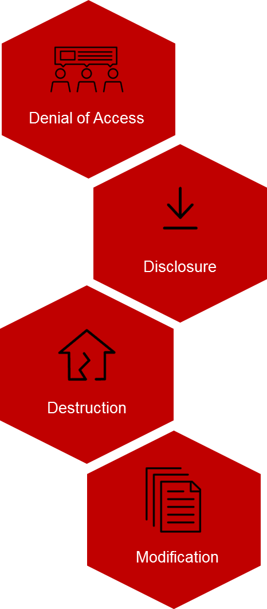
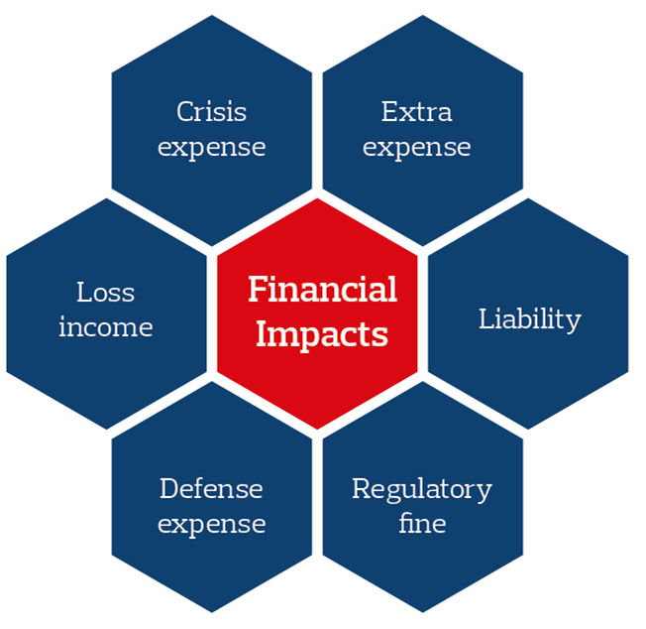
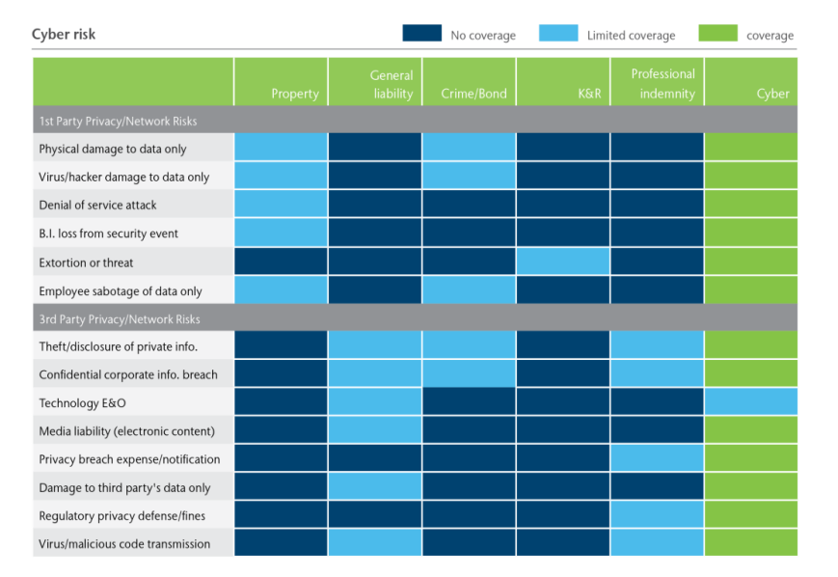
Adopting a Risk-Based Cyber Insurance Strategy
Identify Scenarios
Define Impact
Evaluate Insurance Position

Slide 6
Placement Strategy
Risk
Tolerance
Maximum Probable Loss
Budget
Peer
Purchasing
Data
Contractual Requirements
Scope of Coverage / Control
Optimal Programme
Insurable Risks
Market Limitations

