Slide 1
Cyber Risk & Cyber Insurance - Overview

Slide 2
Cyber Risk Management | Adopting a Risk-Based Cyber Insurance Strategy
Assess
Quantify
Transfer
Respond
Helping clients optimise the total cost of risk associated with cyber exposures
Holistic integration with Enterprise Risk Management (ERM) framework:
appetite, financing, and insurance
Includes harmonized input from Compliance, Legal, Finance, HR, BUs, Internal Audit
+ Cybersecurity and IT

Slide 3
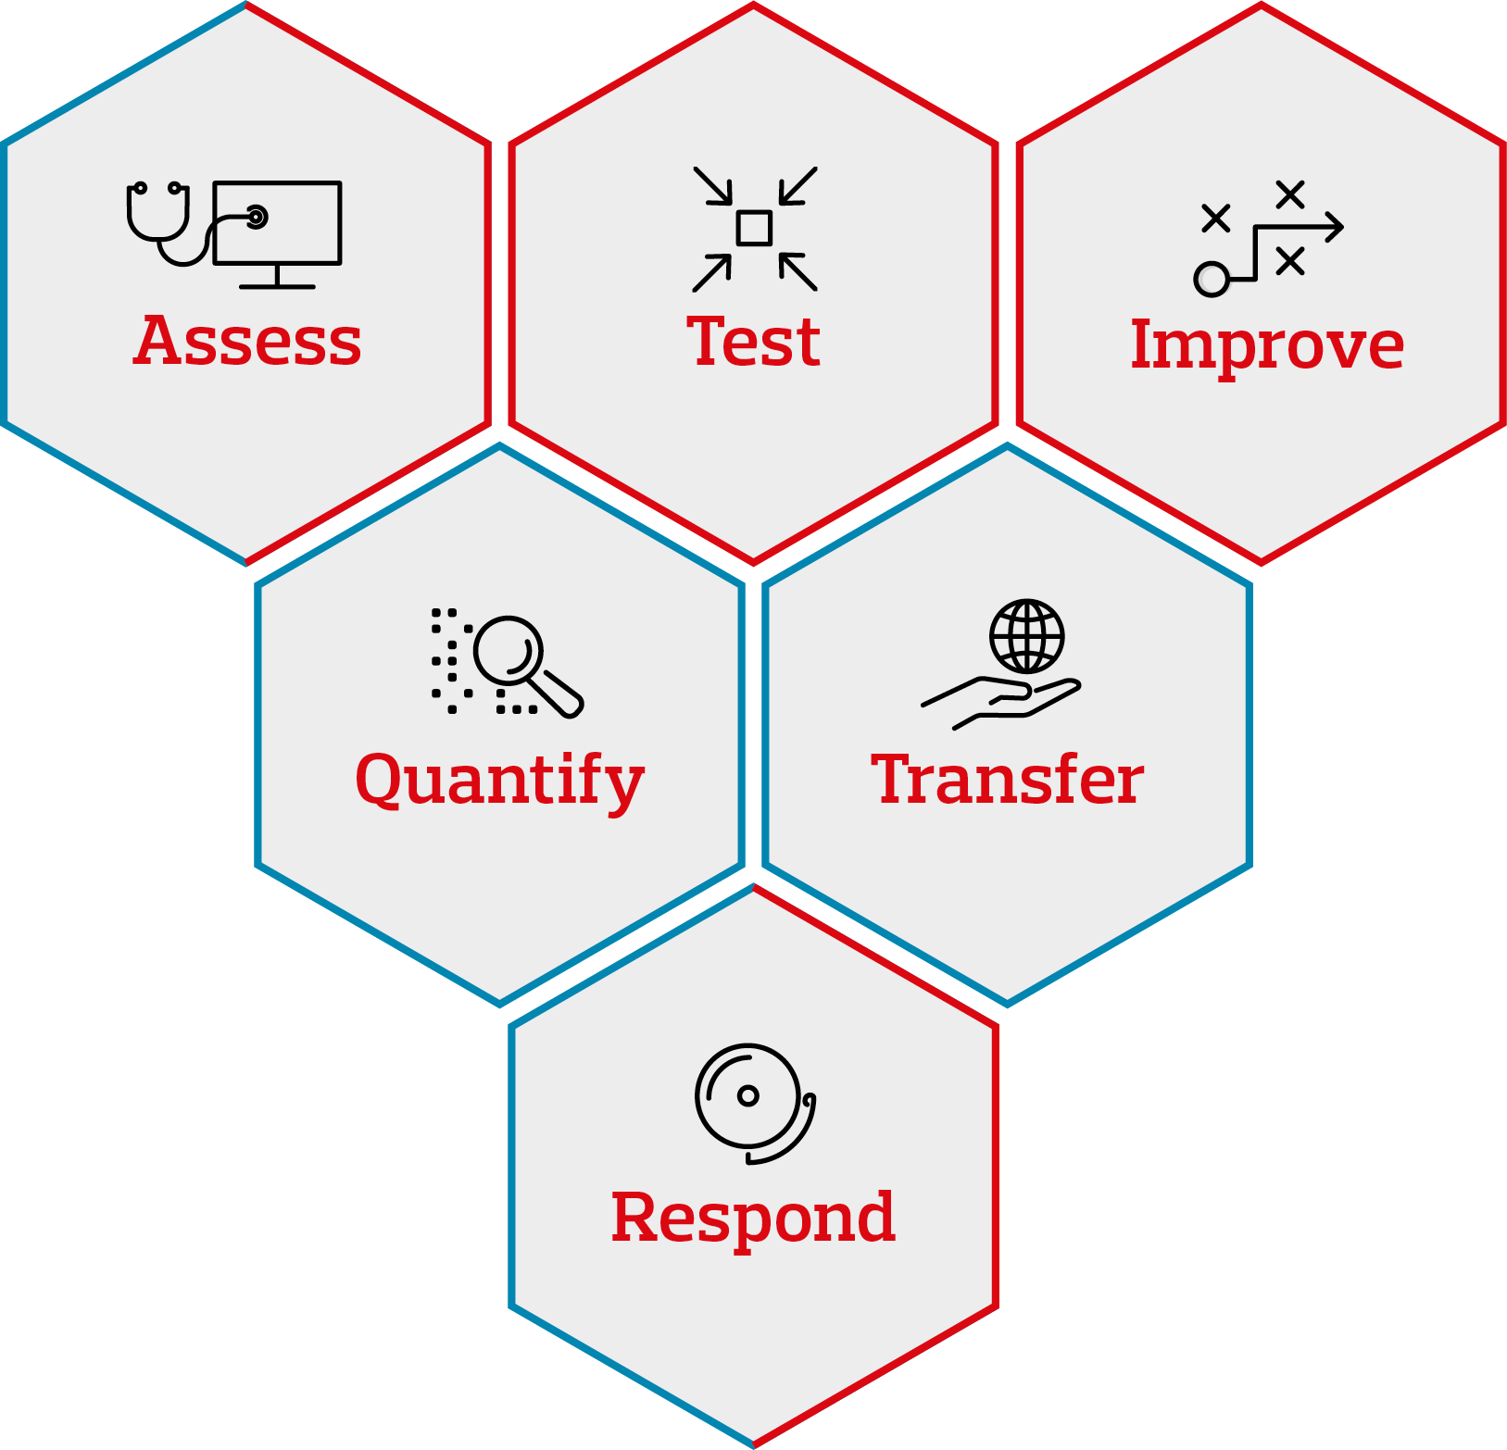
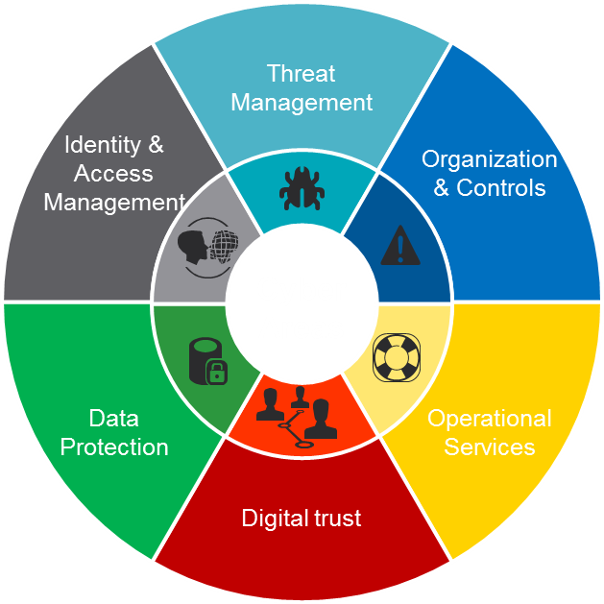
The "integrated" path towards continuous improvement of information security
Strategy
ISMS
Training and awareness
Governance and processes
Asset evaluation and data classification
Policy
Reporting
Threat intelligence
Vulnerability Management
Penetration Test
Ecc.
Identity and access management
Access review
Segregation of duties
Ecc.
Cyber
GDPR
Data privacy management
Data privacy governance
Security Monitoring
Incident Response e Data Breach MGMT
Network & host security
Business Continuity Management & DR
Change Management
Cloud Protection
IOT cybersecurity
Security Awareness
…
Cyber Risk
Management
Cybersecurity
Management

Slide 4
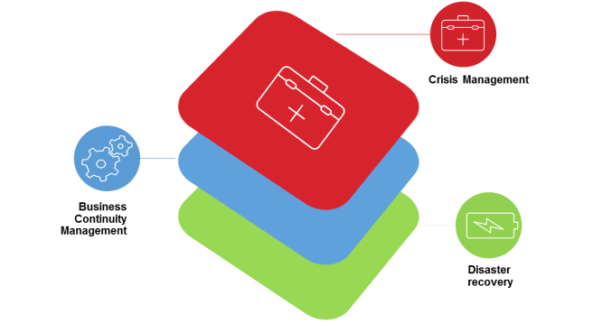
Elements aimed at mitigating the cost of the insurance policy
Revenues from
Online activities
IAM
BCM & DR
BACKUP
AWARENESS

Slide 5
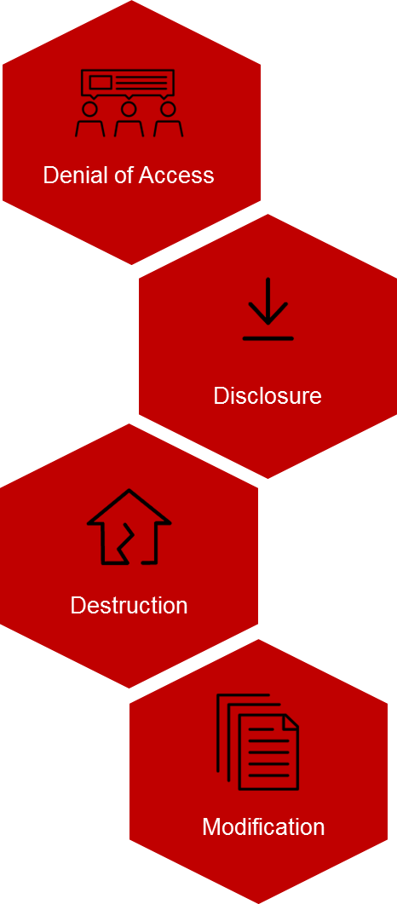
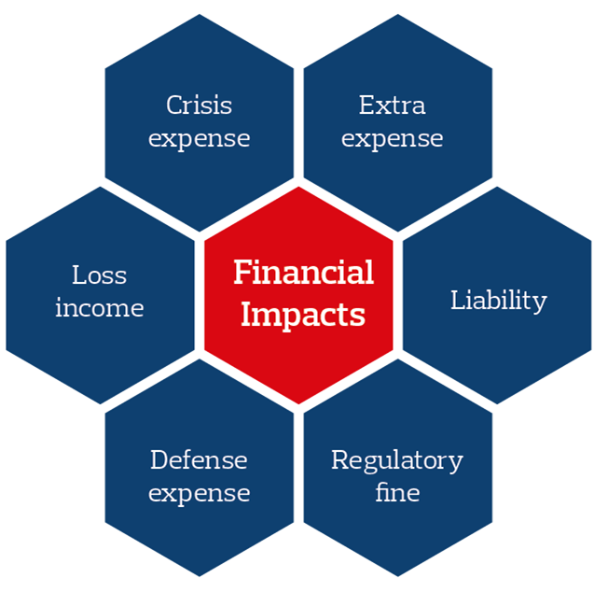
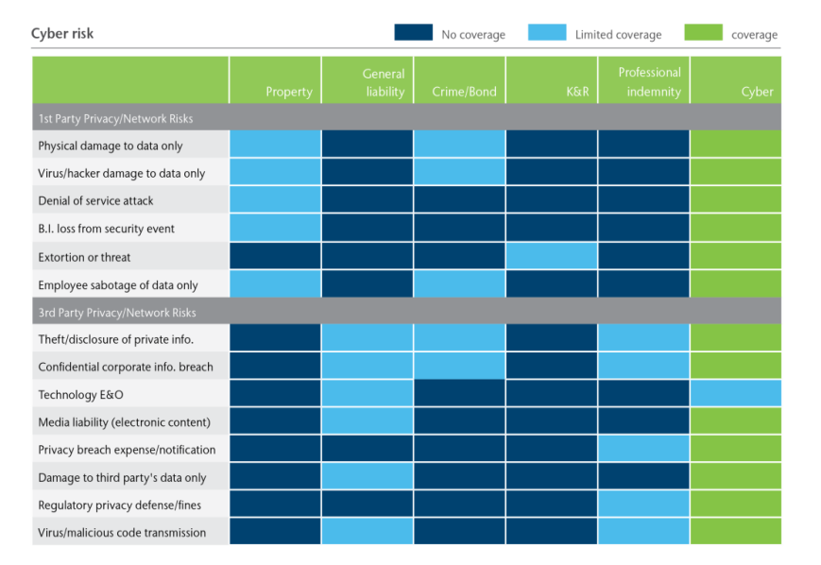
Adopting a Risk-Based Cyber Insurance Strategy
Identify Scenarios
Define Impact
Evaluate Insurance Position

Slide 6
Placement Strategy
Risk
Tolerance
Maximum Probable Loss
Budget
Peer
Purchasing
Data
Contractual Requirements
Scope of Coverage / Control
Optimal Programme
Insurable Risks
Market Limitations

