Slide 1
General presentation of the initiative May 2017 Presented by: Name Lastname, Role – Organisation’s name
www.cyberwatching.eu @cyberwatching.eu
info@cyberwatching.eu

Slide 2
Overview
What is cyberwatching.eu?
Coordination and Support Action (CSA) which aims at building and maintaining the European observatory of research and innovation in the field of cybersecurity and privacy.
Started on 1st May 2017, it will run for 48 months (until April 2021).
Who is involved? A Consortium of Seven European Partners:
PROJECT COORDINATOR
Notes:
Awareness Events - events

Slide 3
Stakeholders & Objectives
5 Marketplace
1 EU R&I Cybersecurity & Privacy Observatory
6 Sustainability model
2 Monitor and cluster cybersecurity & privacy investments in EU & Associated Countries
7 "end-users’ club” for SMEs
3 Support policy, regulatory standards & legal discussions
8 Two versions of an “EU Cybersecurity & privacy Roadmap”
4 Online EU "catalogue of R&I results & solutions“

Slide 4
Our main assets
Research & Innovation Observartory
Concertation Policy & Standards
Market approach & Sustainability
Concertation activities
Policy tracking & evolution
Technology radar
Mapping & clustering of R&I
Observatory
Catalogue of Services
Marketplace
End Users’ Club for SMEs
1
Supply & Demand Marketplace
Early validation & End-user Club for SMEs
2
3
4
The Web Platform is the center of gravity of the project
Notes:
Fulfilling our assets
The hearth of the communication strategy is the Web platform – the main outputs will be showed in it
Catalogue of Services
WE will become the online hub of cybersecurity & privacy
Center of gravity of the project

Slide 5
Asset #1 – Observatory
Monitor all R&I initiatives across EU and at National level
It will collect all on-ongoing activities in the field of cybersecurity & privacy
Feedback in terms of effectiveness & usability of research results
cyberwatching.eu will become the EU’s reference, authoritative, independent source for democratising cybersecurity & privacy to ultimately maximise thematic synergies.
Send us your project’s website and contact point – Be in Cyberwatching.eu radar!
6
Notes:
Results from WP2 from Technology Radar (T2.1 ..

Slide 6
Asset #2 – Catalogue of Services
Online catalogue of R&I results and services, accessible through an online user friendly interface
Projects provide a service-oriented offer, covering what user needs the project services can solve, improving the lives of end-users and the cybersecurity & privacy pain points
Helping R&I initiatives showcasing their results and outputs.
Avoid dispersion of efforts and investments & realise synergies to further encourage excellence.
Are you representing an R&I initiative at EU or National level?
Contact us & be promoted on our Catalogue of Service
7

Slide 7
Asset #3 – Marketplace
A dynamic catalogue of cybersecurity & privacy “services”
The “suppliers” provide cybersecurity & privacy research & innovation results, solutions, tools & trusted services.
The “buyer” partners find answers to their needs!
The win-win mechanism can take place both at research synergy level and at commercial level, in developing new business opportunities
Connecting research results with both demand and supply side of the cybersecurity & privacy industry
Is your initiative developing a cybersecurity product or service?
Be showcased on Cyberwatching.eu Marketplace - soon available!
8

Slide 8
Asset #4 – SME End-User Club
Prime and guided access to the cyberwatching.eu catalogue of services
Ensure feedback in terms of effectiveness and usability of the research results
Highlighting domain specific processes and practices, and defining specific needs
Ensuring that the EU research investments actually address real users’ needs in an effective way
Want to test cybersecurity & privacy solutions for free? Register to Cyberwatching.eu and join the End-User Club!
9

Slide 9
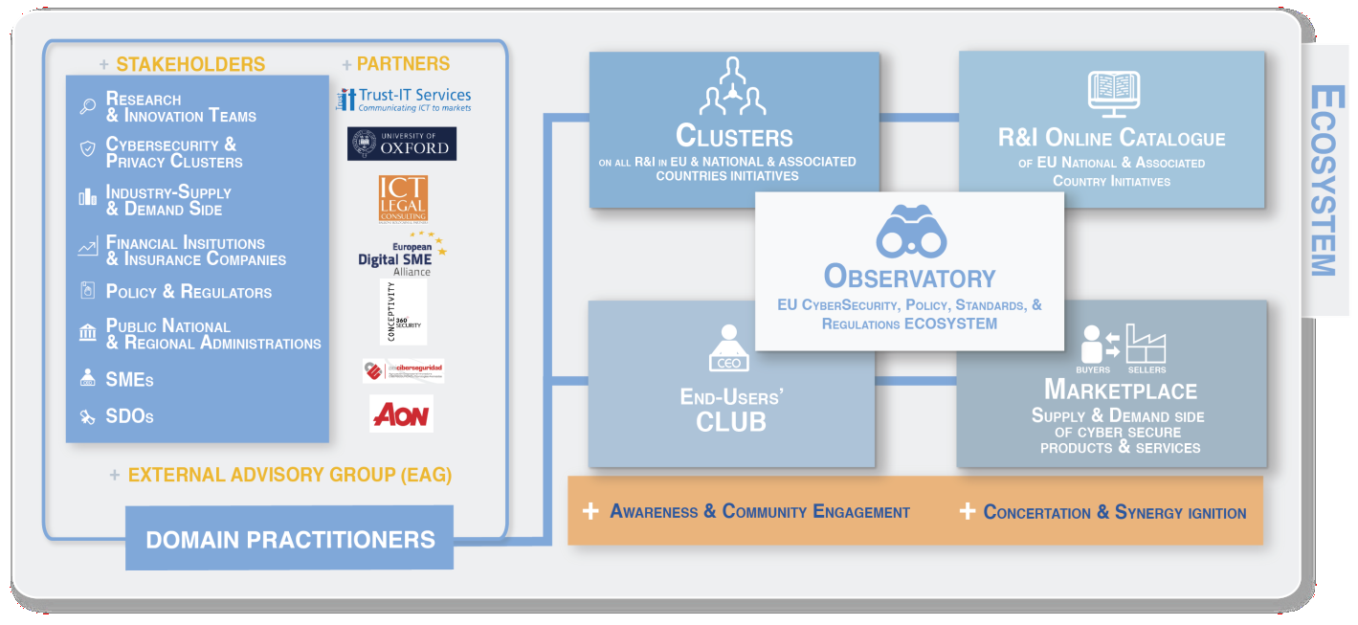
The cybersecurity Ecosystem
An integrated approach to meet the cybersecurity and privacy challenges, joining together specific perspectives and skill-sets from all relevant stakeholders
Be part of the ecosystem – Join Cyberwatching.eu now!

Slide 10
Thank you for your attention! Questions?
Contact
Nick Ferguson, Project Coordinator Trust-IT Services Ltd – www.trust-itservices.com
n.ferguson@trust-itservices.com

