Slide 1
Meeting a growing need in Europe-
Capacity building and new services for SMEs
Cybersecurity Day, Pisa | 11th October 2019
Nicholas Ferguson, Trust-IT Services & Cyberwatching.eu Coordinator
www.cyberwatching.eu
@cyberwatching.eu
info@cyberwatching.eu

Slide 2
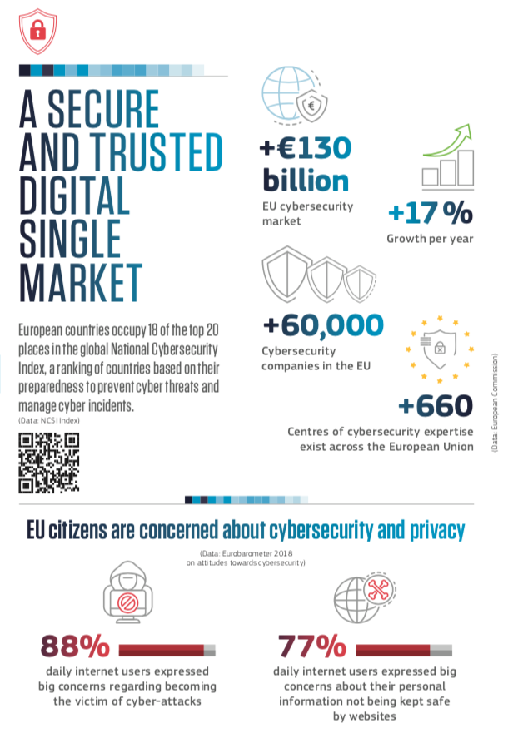
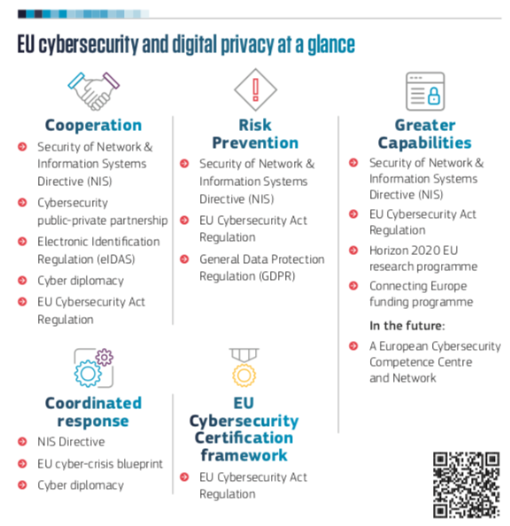
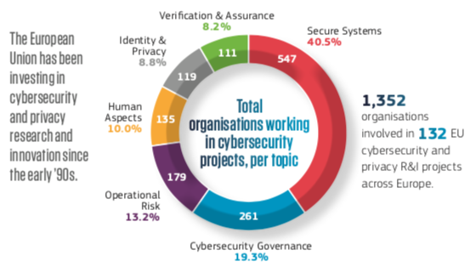

Slide 3


Slide 4
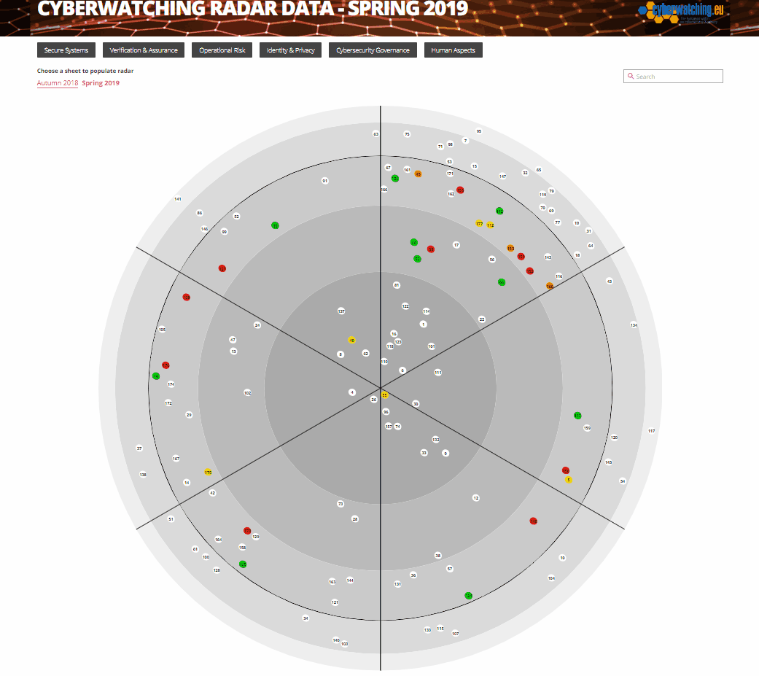

Slide 5



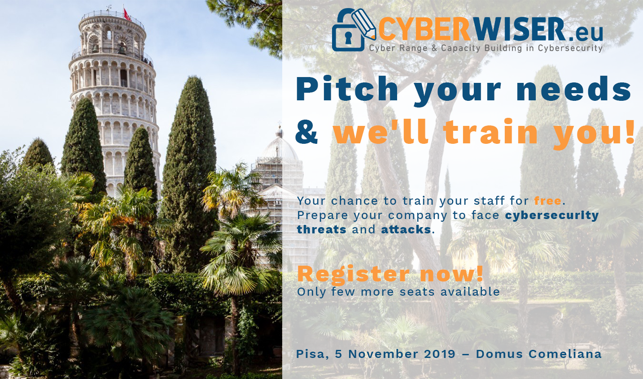
Capacity building for SMEs
Cyber security framework: training courses, real time analysis and monitoring of the CS posture, intrusion detection solutions & more
Collaborative and confidential information sharing, analysis and protection framework as a service for improved cyber security management
Online courses, lessons and training material with a cyber range environment to run simulated attack based on real-world scenarios
Pitch your needs & we'll train you!
Pisa, 5/11/2019
The workshop will present the CYBERWISER.eu online integrated platform for organisation, SMEs and public administration to train their staff with a simulated environment of cyber incidents and attacks where IT professionals can hone and evolve their skills, continuously evaluating their performance as they prepare for future real attack episodes.

Slide 6

https://www.cyberwatching.eu/market-products-list

Slide 7
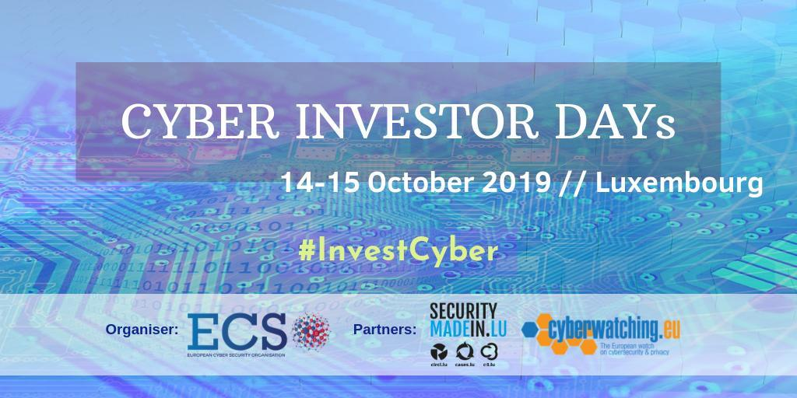
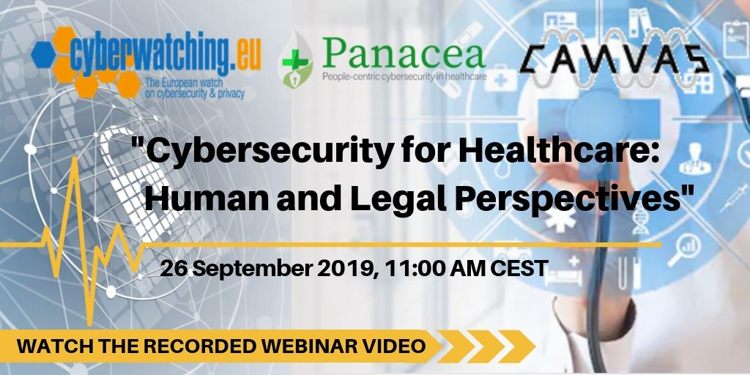
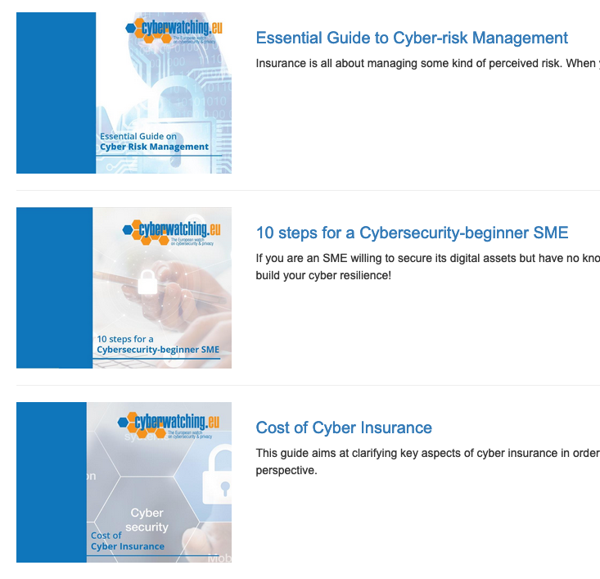

Capacity building for SMEs
22 Startups - How to pitch to investors
PR, marketing and communicating your idea to the market is nearly as important as having innovative technology.
Bi-monthly webinars
Free online guides

Slide 8


Coming extremely soon…

Slide 9
Grazie…
Nicholas Ferguson
Trust-IT Services
n.ferguson@trust-itservices.com

