Slide 1
BRIDGING R&I WITH
THE BUSINESS WORLD
BY CYBERWATCHING.EU
THE EUROPEAN OBSERVATORY OF RESEARCH AND INNOVATION ON CYBERSECURITY AND PRIVACY

Slide 2




WELCOME MESSAGE
Javier Tobal
Project Manager
AEI Ciberseguridad
AEI Ciberseguridad y Tecnologías avanzadas
javier.tobal@aeiciberseguridad.es
www.aeiciberseguridad.es
@javitobal
@aeiciberseg

Slide 3

CYBERWATCHING.EU
Mark Miller
CEO
Conceptivity
mrmiller@conceptivity-switzerland.com
www.conceptivity-switzerland.com
@CONCEPTIVITY_CH

Slide 4
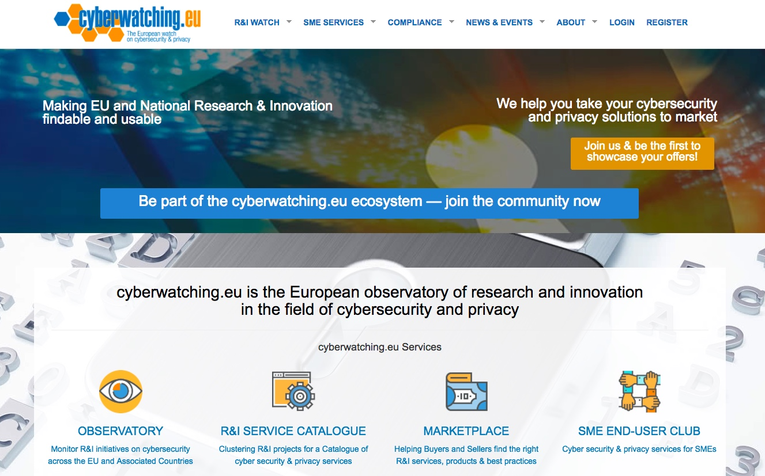
CYBERWATCHING.EU

Slide 5








CYBERWATCHING.EU
www.cyberwatching.eu
@cyberwatching.eu
info@cyberwatching.eu

Slide 6


PANEL DISCUSSION
Laura Senatore
Associate
ICT Legal Consulting
ICT Legal Consulting Balboni Bolognini & Partners
laura.senatore@ictlegalconsulting.com
www.ictlegalconsulting.com
@ictlc
@laurasenatore

Slide 7

PANEL DISCUSSION
Pablo Montoliu Zunzunegui
Chief Information & Innovation Officer
AON
www.aon.es
pablo.montoliu@aon.es
@Aon_Espana

Slide 8

PANEL DISCUSSION
Raúl Pérez García
Global Presales Manager
Panda Security
comunicación@pandasecurity.com
www.pandasecurity.com
@PandaComunica

Slide 9

Thank you for your attention!
www.cyberwatching.eu
@cyberwatching.eu
info@cyberwatching.eu
Cyberwatching.eu has received funding from the European Union’s Horizon 2020 research and innovation programme under grant agreement No 740129.

