Slide 1
Visualising the EC H2020 Cybersecurity (Research) landscape
9-10 September 2019
Oxford, UK

Slide 2







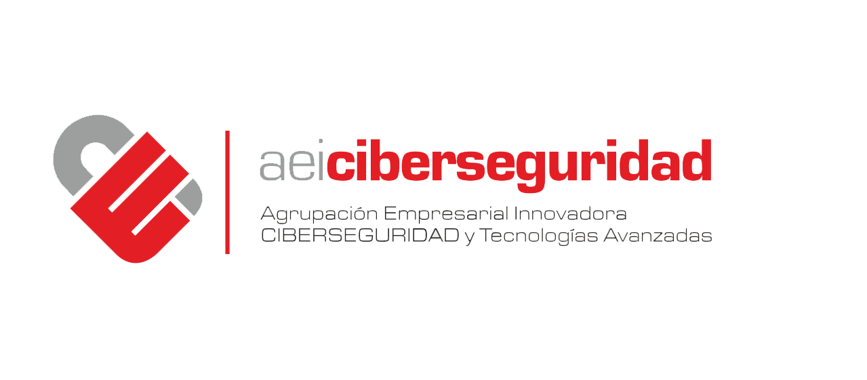




Overview
What is cyberwatching.eu?
  Coordination and Support Action (CSA) which aims at building and maintaining the European observatory of research and innovation in the field of cybersecurity and privacy.
  Started on 1st May 2017, it will run for 48 months (until April 2021).
Who is involved? A Consortium of Seven European Partners:
PROJECT COORDINATOR

Slide 3
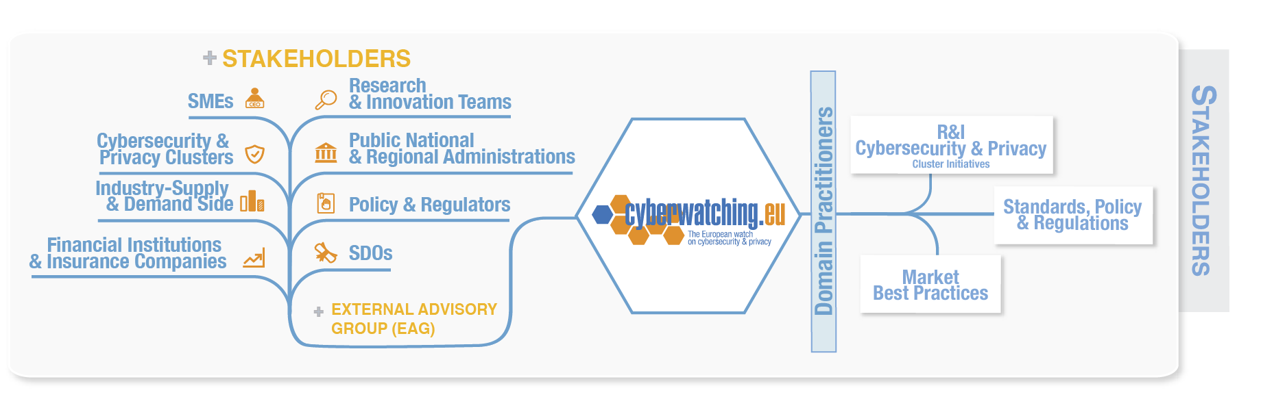

Stakeholders & Objectives
5 Marketplace
1 EU R&I Cybersecurity & Privacy Observatory
6 Sustainability model
2 Monitor and cluster cybersecurity & privacy investments in EU & Associated Countries
7 "end-users’ club” for SMEs
3 Support policy, regulatory standards & legal discussions
8 Two versions of an “EU Cybersecurity & privacy Roadmap”
4 Online EU "catalogue of R&I results & solutions“

Slide 4
EU H2020 Cybersecurity research
180 projects
Spanning 15 years
(Feb 2008 – Feb 2023)
€765M total budget

Slide 5

The needle in the haystack
Hello, anybody out there?

Slide 6

The needle in the haystack
Well, hello there!

Slide 7
Devising the magnet
A taxonomy as first-level decomposition tool
An appropriate visualisation tool
A set of distinguishing parameters
Data gathering

Slide 8
Cyberwatching.eu cybersecurity & privacy taxonomy
Foundational technical methods & risk management for trustworthy systems in cybersecurity & privacy
Operational Risk and Analytics
Verification and Assurance
Applications and user-oriented services to support cybersecurity and privacy
Secure Systems and Technology
Identity, Behaviour, Ethics and Privacy
Policy, governance, ethics, trust, and usability, human aspects of cybersecurity & privacy.
National and international security and governance
Human Aspects of Cybersecurity
Taxonomy Level 1: Category
Taxonomy Level 2: Cluster
Notes:
This is our full taxonomy in a hierarchical level view:
Level 2 carries the term “cluster”, which is the desired level of detail of our work.
The hierarchical relationship is “member of”, i.e. a cluster is a member of a category.

Slide 9
Cyberwatching.eu cybersecurity & privacy taxonomy
Secure Systems and Technology
Operational Risk and Analytics
Identity, Behaviour, Ethics and Privacy
National and international security and governance
Verification and Assurance
Human Aspects of Cybersecurity
Notes:
This diagram depicts the functional relationship of clusters.
4 technical development areas
2 Social or service based cross cutting areas

Slide 10
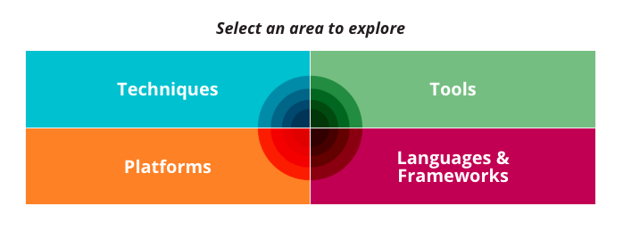
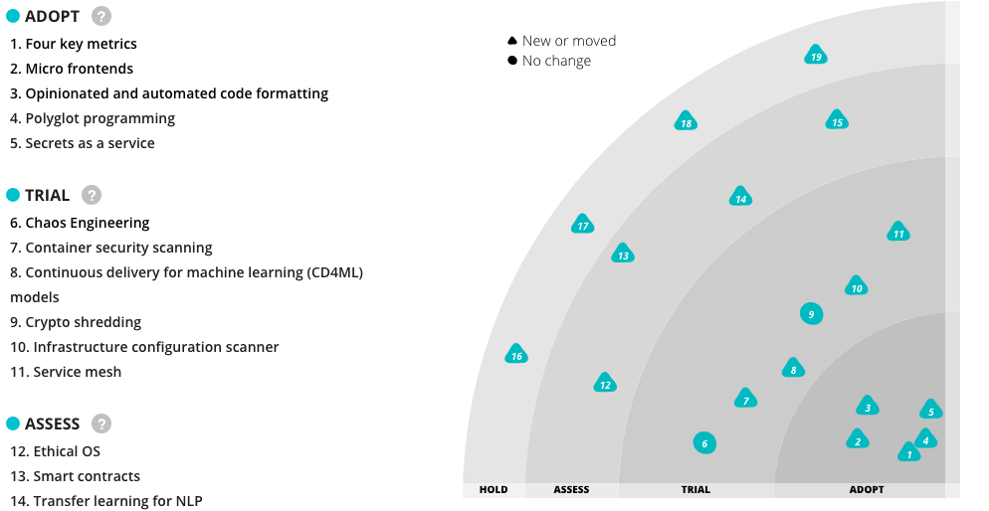
Visualisation:
TW Technology radar
https://www.thoughtworks.com/radar

Slide 11
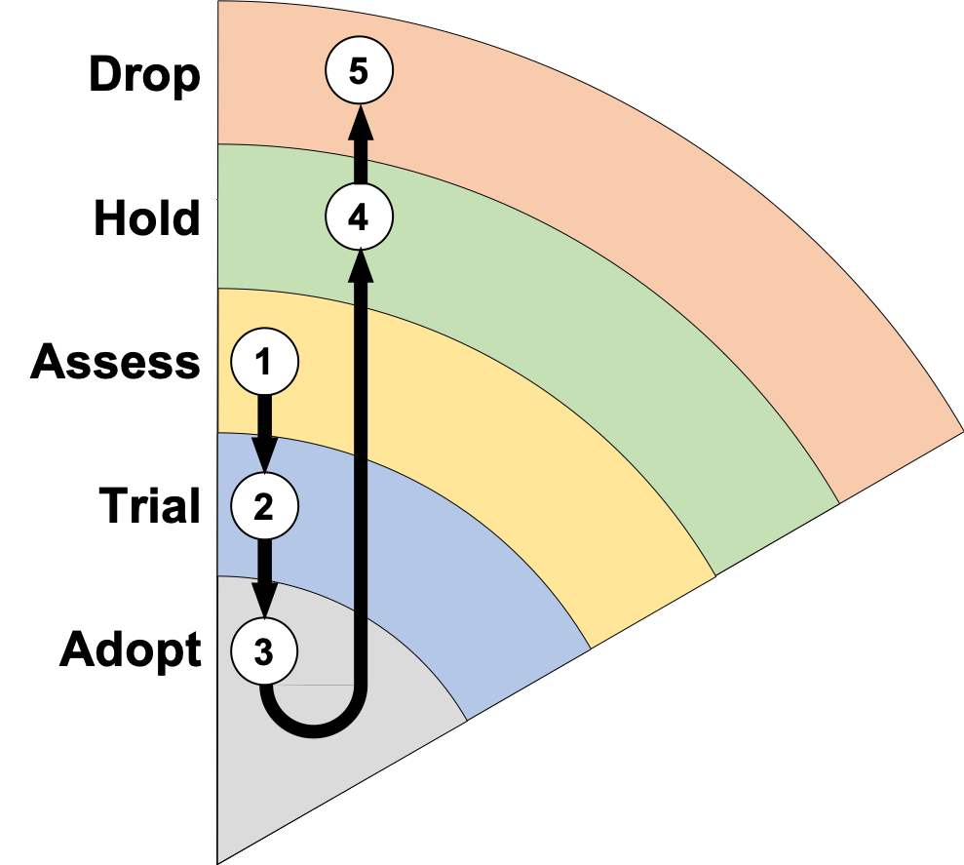
Cyberwatching radar parameters
6 Sectors
All 6 level 2 taxonomy terms
5 Rings
Project lifecycle progress
5-colour spectrum
Project outputs maturity relative
to min, max & mean score
Radar blips
One for each project
Assess → Trial → Adopt → Hold → Drop
2
2
2
2
2
2
2

Slide 12
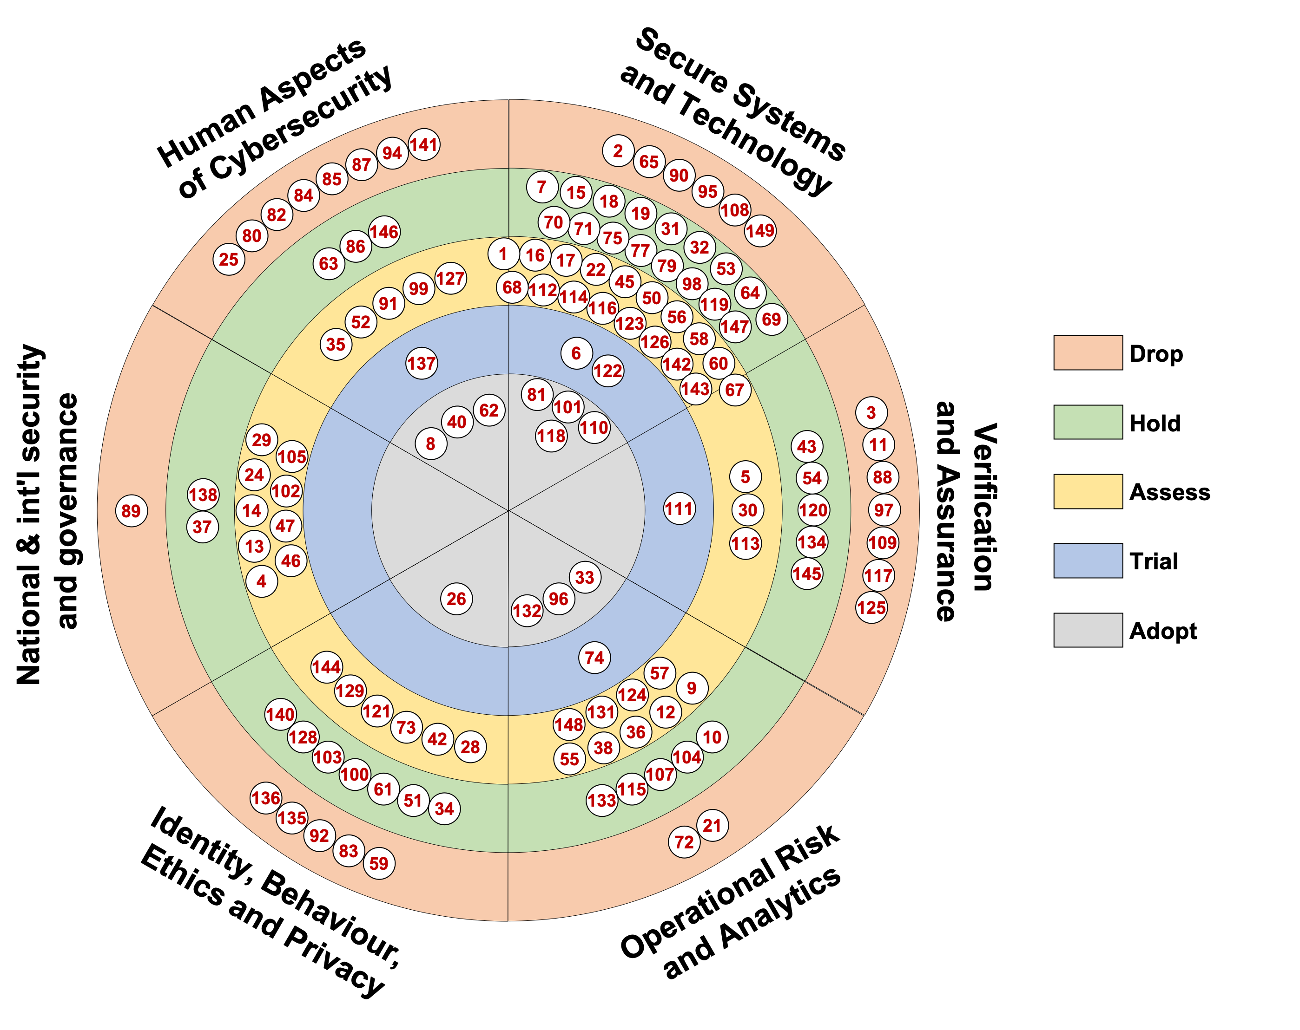
Autumn 2018
Technology Radar
# projects | Assess | Trial | Adopt | Hold | Drop
134 | 49 | 6 | 11 | 39 | 29
 | 36% | 4% | 8% | 29% | 21%

Slide 13
Data gathering:
How do we get there?
Collect project core data
Classify projects against taxonomy
Reach out to projects for self-assessment on MTRL scale
Collate, aggregate and visualise
Annotate and embed in Cyberwatching.eu observatory & project hub

Slide 14
(1) Collect core data
# | Project | Call | Type | Start | End
162 | ASTRID | H2020-DS-SC7-2017 | RIA | May 2018 | Apr 2021
163 | BPR4GDPR | H2020-DS-SC7-2017 | IA | May 2018 | Apr 2021
164 | PAPAYA | H2020-DS-SC7-2017 | IA | May 2018 | Apr 2021
165 | POSEIDON | H2020-DS-SC7-2017 | IA | May 2018 | Oct 2020
166 | SPEAR | H2020-DS-SC7-2017 | RIA | May 2018 | Apr 2021
167 | SMOOTH | H2020-DS-SC7-2017 | IA | May 2018 | Oct 2020
168 | DEFEND | H2020-DS-SC7-2017 | IA | Jun 2018 | May 2021
169 | CE-IoT | H2020-MSCA-RISE-2017 | MSCA-RISE | Jul 2018 | Jun 2022
Notes:
These are mapping examples of some of the projects present at the workshop.
Note and highlight that projects may have all three categories in scope for their work
Based on their proposal, some focus on issues in just one category! And that’s fine!

Slide 15
(2) Classify against taxonomy
Project | Rank 1 | Rank 2 | Rank 3
ASTRID | Apps & user oriented services | Found. of tech & risk management
BPR4GDPR | Apps & user oriented services | Governance, Ethics, Trust
PAPAYA | Apps & user oriented services
POSEIDON | Apps & user oriented services | Governance, Ethics, Trust
SPEAR | Apps & user oriented services
SMOOTH | Governance, Ethics, Trust | Apps & user oriented services
DEFEND | Governance, Ethics, Trust | Apps & user oriented services
CE-IoT
Classification on taxonomy level 1
Notes:
These are mapping examples of some of the projects present at the workshop.
Note and highlight that projects may have all three categories in scope for their work
Based on their proposal, some focus on issues in just one category! And that’s fine!

Slide 16
(2) Classify against taxonomy
Radar segment
Project | Rank 1.a | Rank 1.b | Rank 2.a | Rank 2.b
ASTRID | Secure Systems |  | Operational Risk
BPR4GDPR | Identity & Privacy |  | Cybersecurity Governance
PAPAYA | Identity & Privacy | Secure Systems
POSEIDON | Identity & Privacy | Secure Systems
SPEAR | Secure Systems | Identity & Privacy
SMOOTH | Cybersecurity Governance | Human Aspects | Identity & Privacy | Secure Systems
DEFEND | Cybersecurity Governance | Human Aspects | Identity & Privacy
CE-IoT
Classification on taxonomy level 2
Notes:
These are mapping examples of some of the projects present at the workshop.
Note and highlight that projects may have all three categories in scope for their work
Based on their proposal, some focus on issues in just one category! And that’s fine!

Slide 17
(3) MTRL self-assessment
Technology Readiness Level (TRL) | Level | Market Readiness Level (MRL)
Idea | 0 | Hunch
Basic research | 1 | Basic research
Technology formulation | 2 | Needs formulation
Applied research | 3 | Needs validation
Small scale prototype | 4 | Small scale stakeholder campaign
Large scale prototype | 5 | Larger scale early adopter campaign
Prototype system | 6 | Proof of traction
Demonstration system | 7 | Proof of satisfaction
First of a kind commercial system | 8 | Proof of scalability
Full commercial application | 9 | Proof of stability

Slide 18
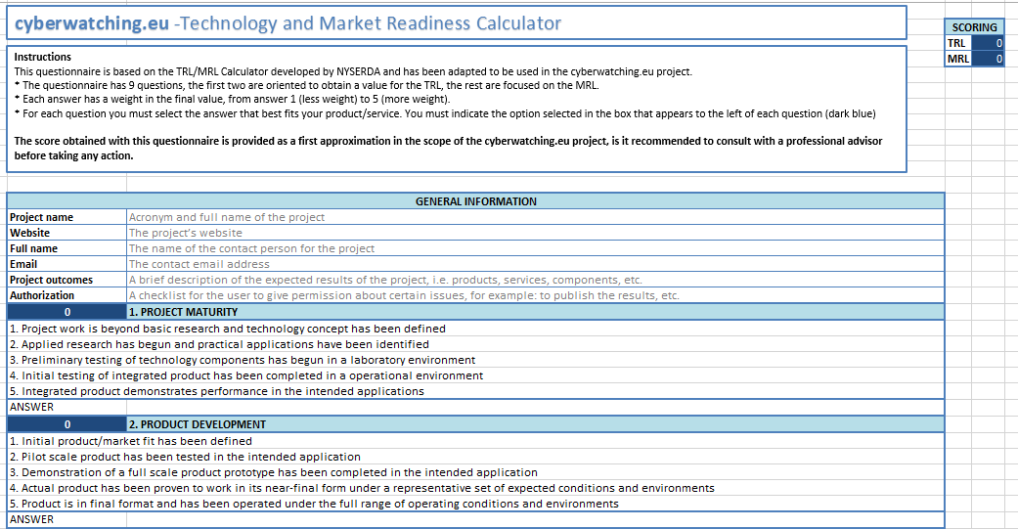
(3) MTRL self-assessment
Contact projects, asking to fill out an easy questionnaire
MTRL score calculated and sent back to us

Slide 19
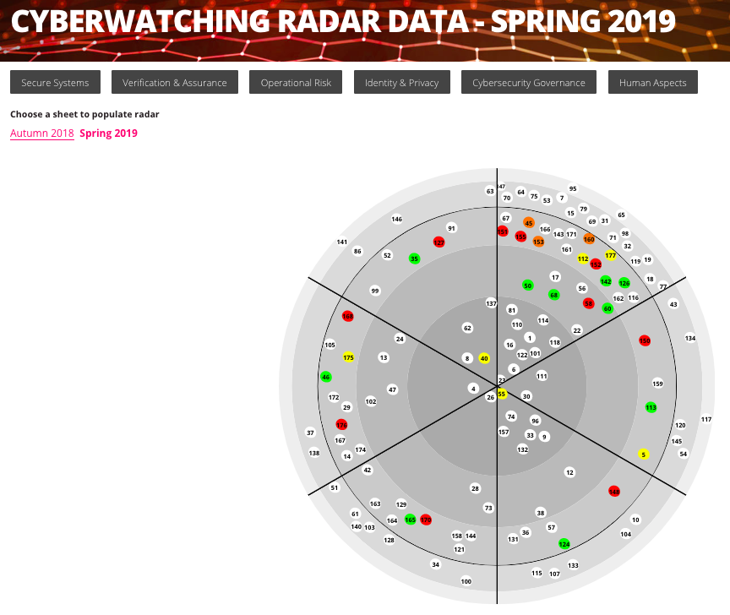
(4) Collate, aggregate, visualise

Slide 20
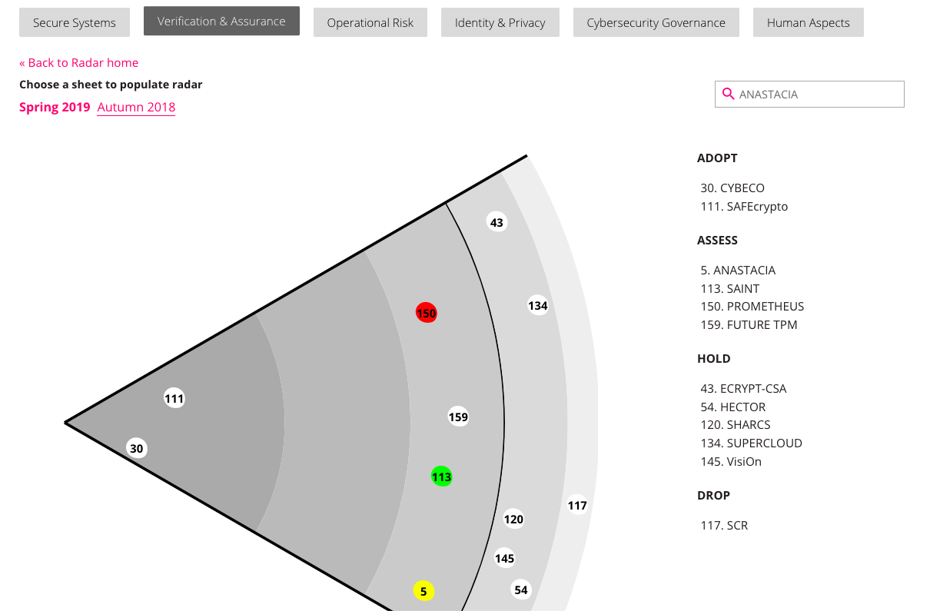
(4) Collate, aggregate, visualise

Slide 21
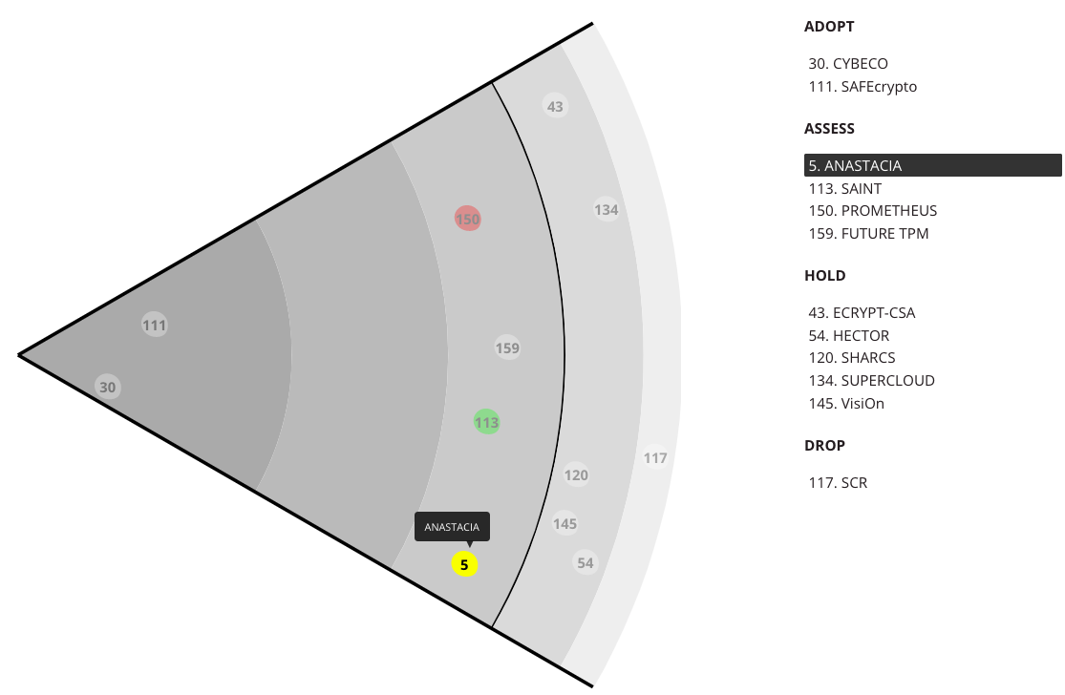
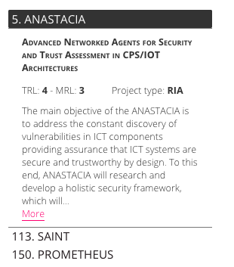
(5) Integrate with project hub

Slide 22
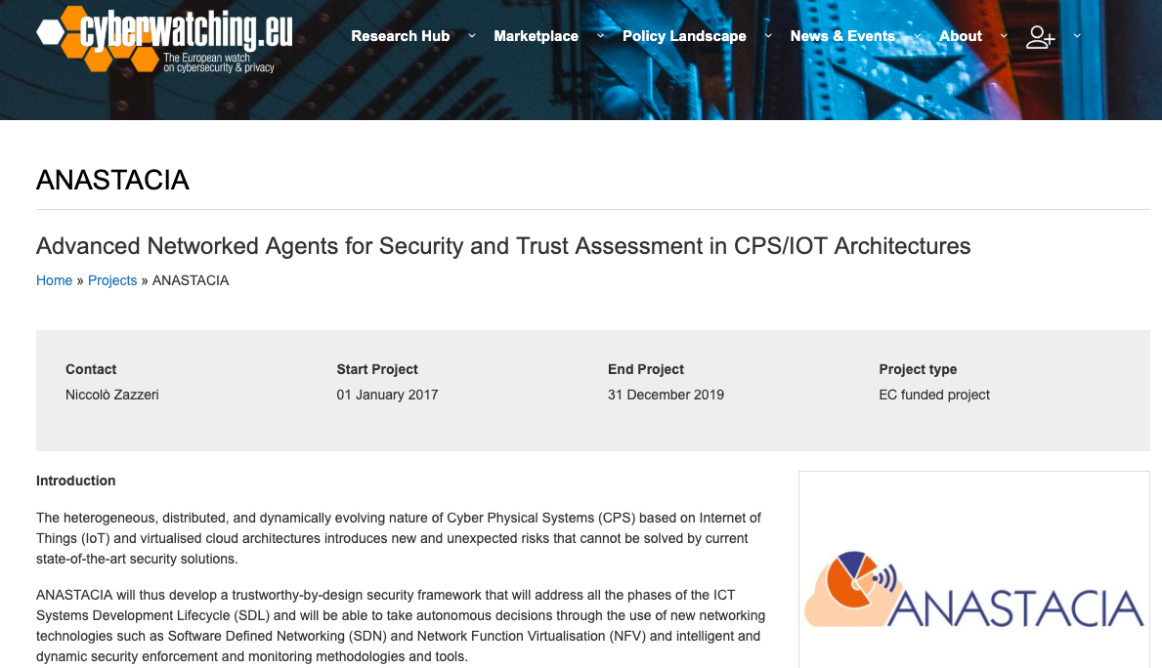
(5) Integrate with
ProjectHUB

Slide 23
Demo time!

