Slide 1



GDPR for SMEs webinar
15 June 2018

Slide 2
Today’s Agenda
10:00 - 10:05 Introduction
10:05-10:20 'GDPR and SMEs: A practical look at the main duties and obligations and how to comply with them', Laura Senatore, Privacy & data protection lawyer, Senior Associate at the ICT Legal Consulting
10:20 - 10:35 'Data protection by design (Art. 25.1 of the GDPR) - what does it mean for SMEs', Lina Jasmontaite, Doctoral researcher at Vrije Universiteit Brussel (VUB)
10:35 - 11:00 Q&A session: what do you want to know about the GDPR?

Slide 3
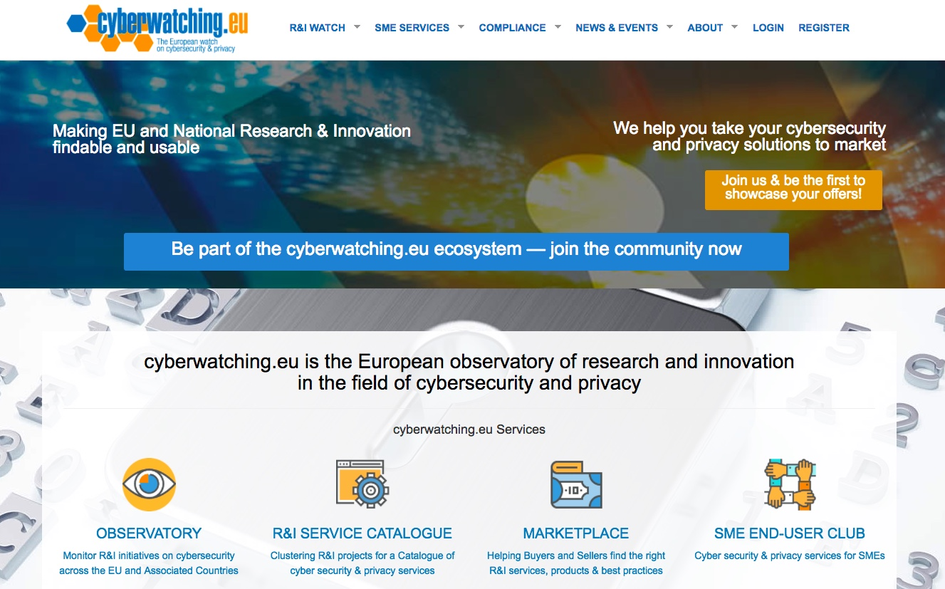
Our main assets are:
Observatory, Service catalogue, Marketplace and SME end-user club

Slide 4

SME End-User Club
Free cybersecurity & privacy services & and tips tailored for SME pain points
Sign up today: https://cyberwatching.eu/sme-end-user-club-registration
5

Slide 5

Join our exclusive SME end-user club
Free & affordable & cutting-edge cyber-security & privacy services & products
Participation at SME workshops, webinars and access to expert guides on cyber-insurance, legal (e.g. GDPR), certification & standardisation
Networking opportunities with an expanding network of SMEs across Europe and globally
Free visibility on Europe’s independent cybersecurity & privacy online hub – www.cyberwatching.eu
Discounted professional cyberinsurance, GDPR consultancy and other services
Sign up here http://bit.ly/2gc3uS2

Slide 6

GDPR Training for SMEs
With the GDPR recently became mandatory,
this intensive training session is a great opportunity both for companies that need to be compliant and for those that want to offer new services to their clients.
The upcoming second session of the training will take place 29th-30th June in Brussels and its open for registration.
Details and agenda can be found here: https://www.digitalsme.eu/projects/gdpr/
Special discount. SME end-user club members get 10% discount. Interested companies can email gdpr@digitalsme.eu to receive their quote.

